Slide 1
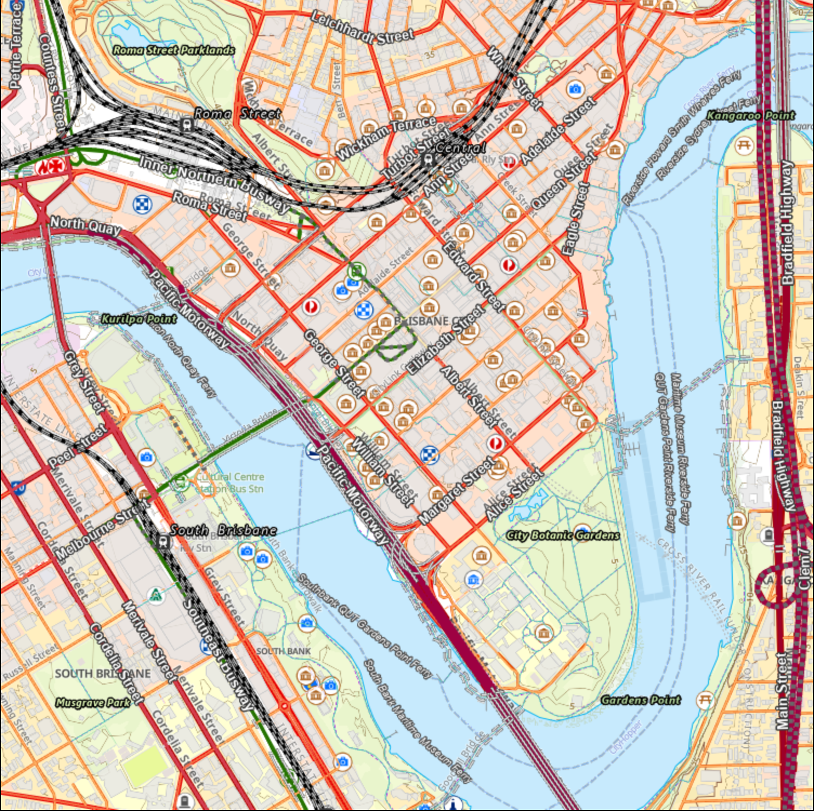
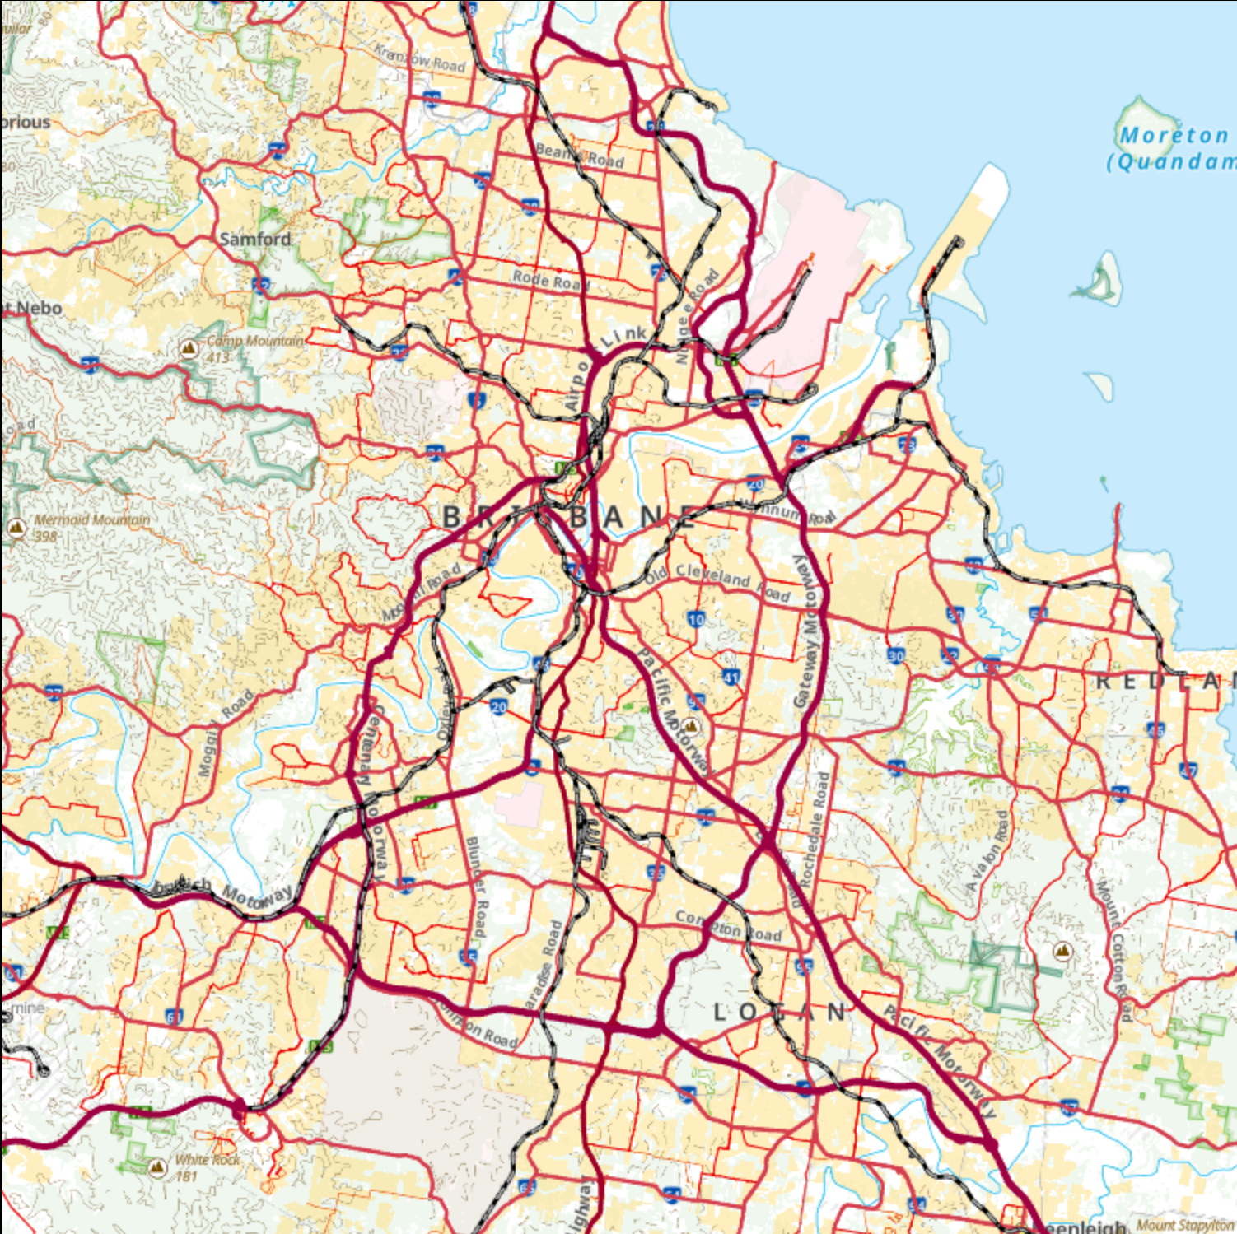
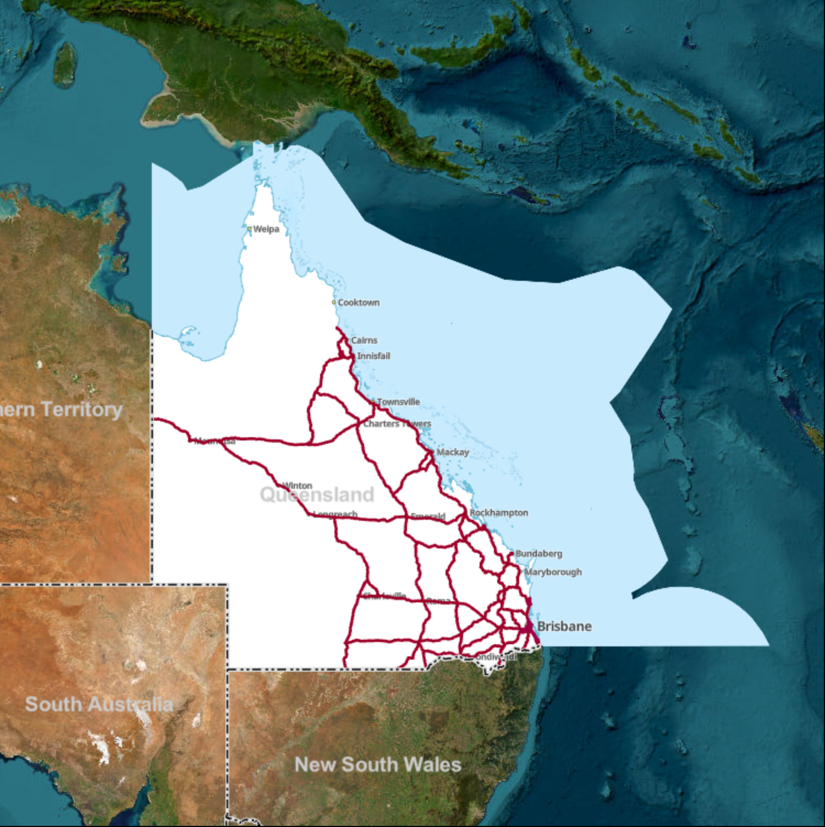
Introduction to ArcGIS for Transport Applications

Slide 2
Content
What is ArcGIS
Usefulness of ArcGIS
What can you do with ArcGIS
Navigating ArcGIS
ArcGIS Project
Create an ArcGIS project and load Data/Map
Data and map information
Attribute Table and its functionality
Selection, filtering, and subsetting data
Load spatial point data (Annual Average Daily Traffic data)
Using selection tool
Finding intersections
Add new fields to the intersection and intersection link attribute tables and populating them with relevant information

Slide 3
ArcGIS development
ArcGIS is a Geographic Information System (GIS) software developed and maintained by Esri.
Esri – the Environmental Systems Research Institute
Esri aims to enable people to gain useful insights through geography
There are users in every country, with over a million active users across 350,000 organisations.
Currently available tools :
ArcGIS Pro
ArcGIS Online
ArcGIS Enterprise

Slide 4
ArcGIS Pro
64 Bit, multi-threaded
Simplified user interface
Integrated with ArcGIS Online
Combined 2D/3D experience
Multiple maps and layouts
All the analysis tools
Simple search and query

Slide 5
What can you do with ArcGIS
ArcGIS is a mapping and spatial analysis platform
It helps users visualize, analyze, and manage geographic data
It is widely used in:
Urban and transport planning
Road safety analysis
Infrastructure design
Environmental impact assessment

Slide 6
Use of GIS in Transport planning
Map road networks, traffic flows, crashes
Analyze accessibility and route efficiency
Identify risk areas (e.g., high crash zones)
Model travel behavior and infrastructure demand
Data types in ArcGIS
Vector data:
Points (bus stops, crashes)
Lines (road links, routes)
Polygons (suburbs, zones)
Raster data:
Used for terrain and land cover

Slide 7
What can you do with ArcGIS?
Analysis
Analysis Ribbon
Geoprocessing pane
Model-builder
Python window
Network Analysis
Image and Raster Analysis
Visualization
Multiple layouts
Transparency
3D cartography
Map Series
Animation

Slide 8
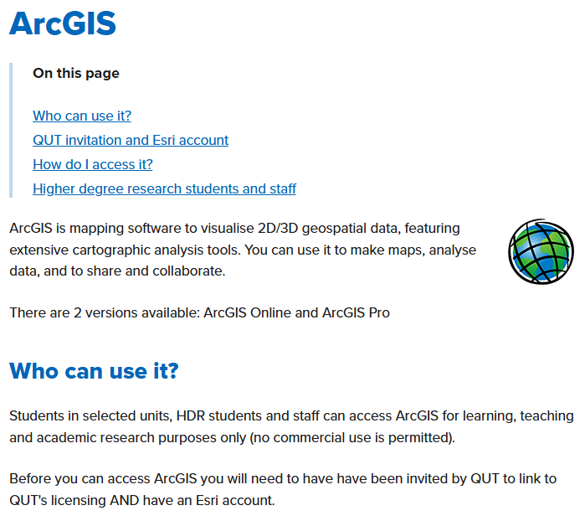

Slide 9
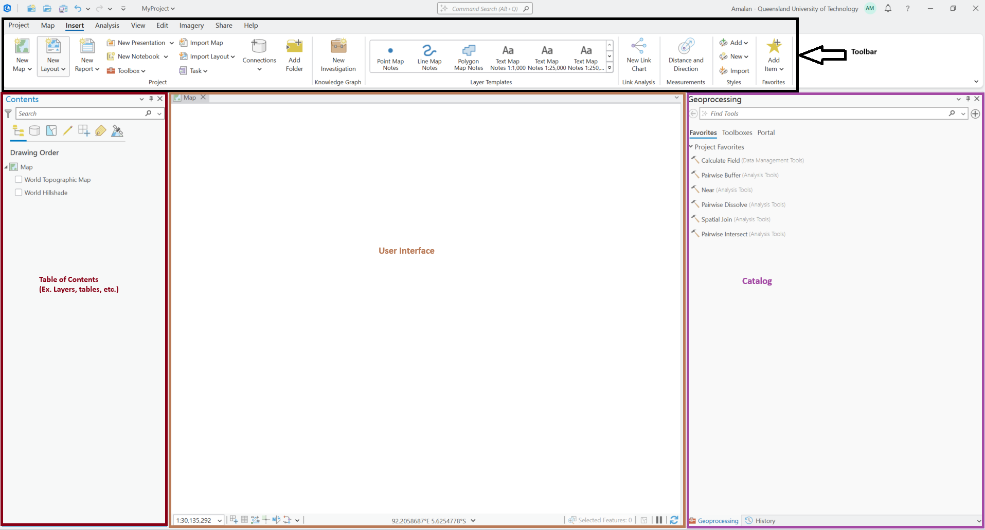
Navigating ArcGIS

Slide 10
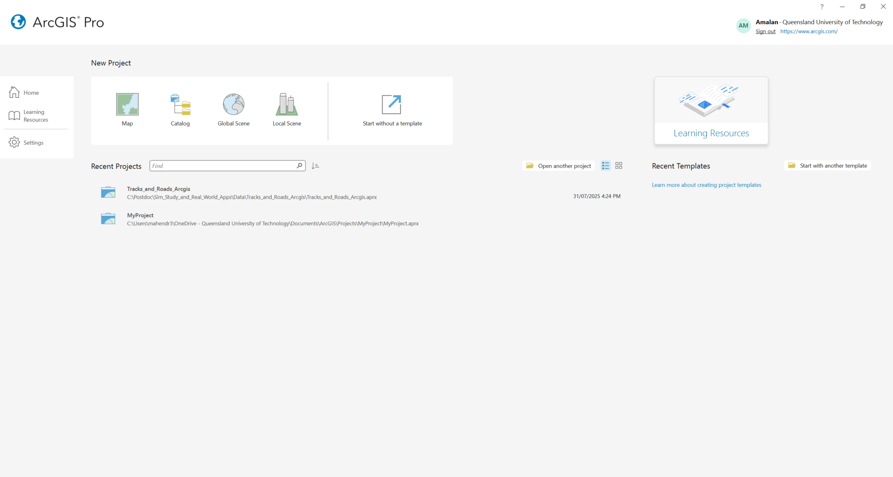
ArcGIS Project

Slide 11
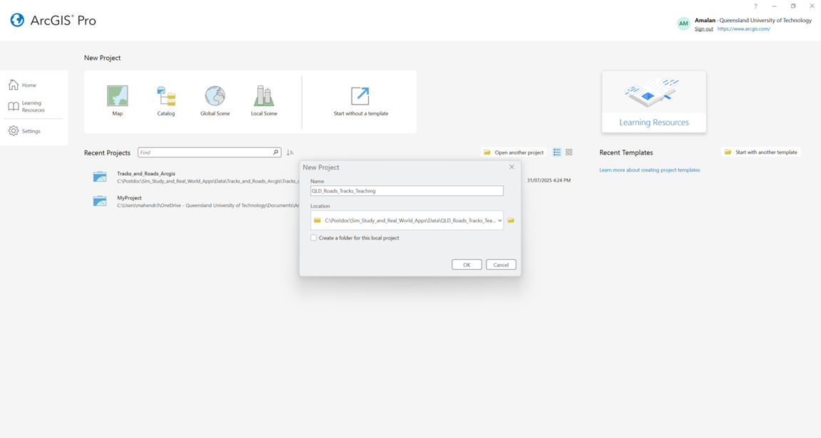
New ArcGIS Project Map > “Select a Location” > Enter the name “QLD_Roads_Tracks_Teaching”

Slide 12
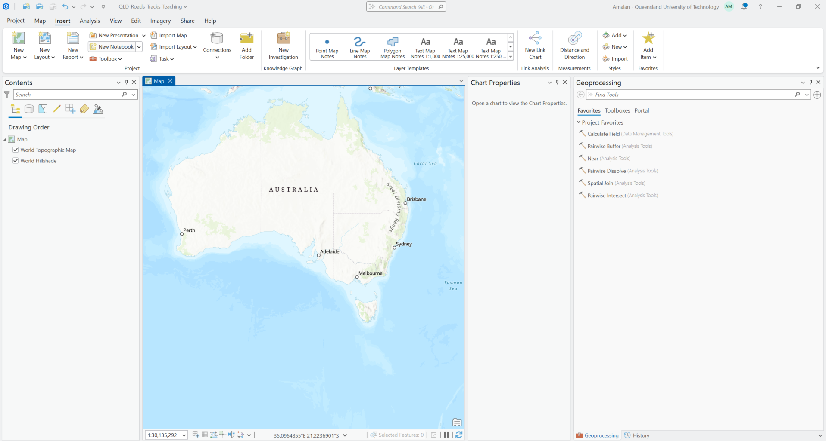
ArcGIS Project

Slide 13
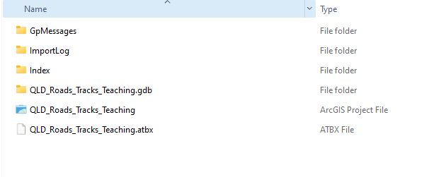
Project Folder

Slide 14
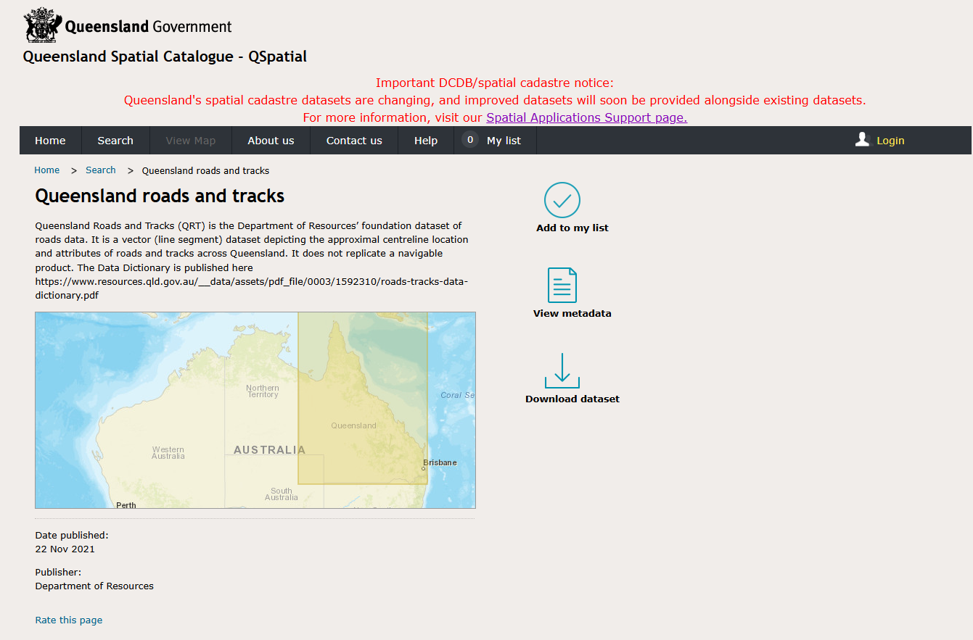
QLD roads and tracks data

Slide 15
QLD roads and tracks data
Data is available in the OneDrive folder

Slide 16
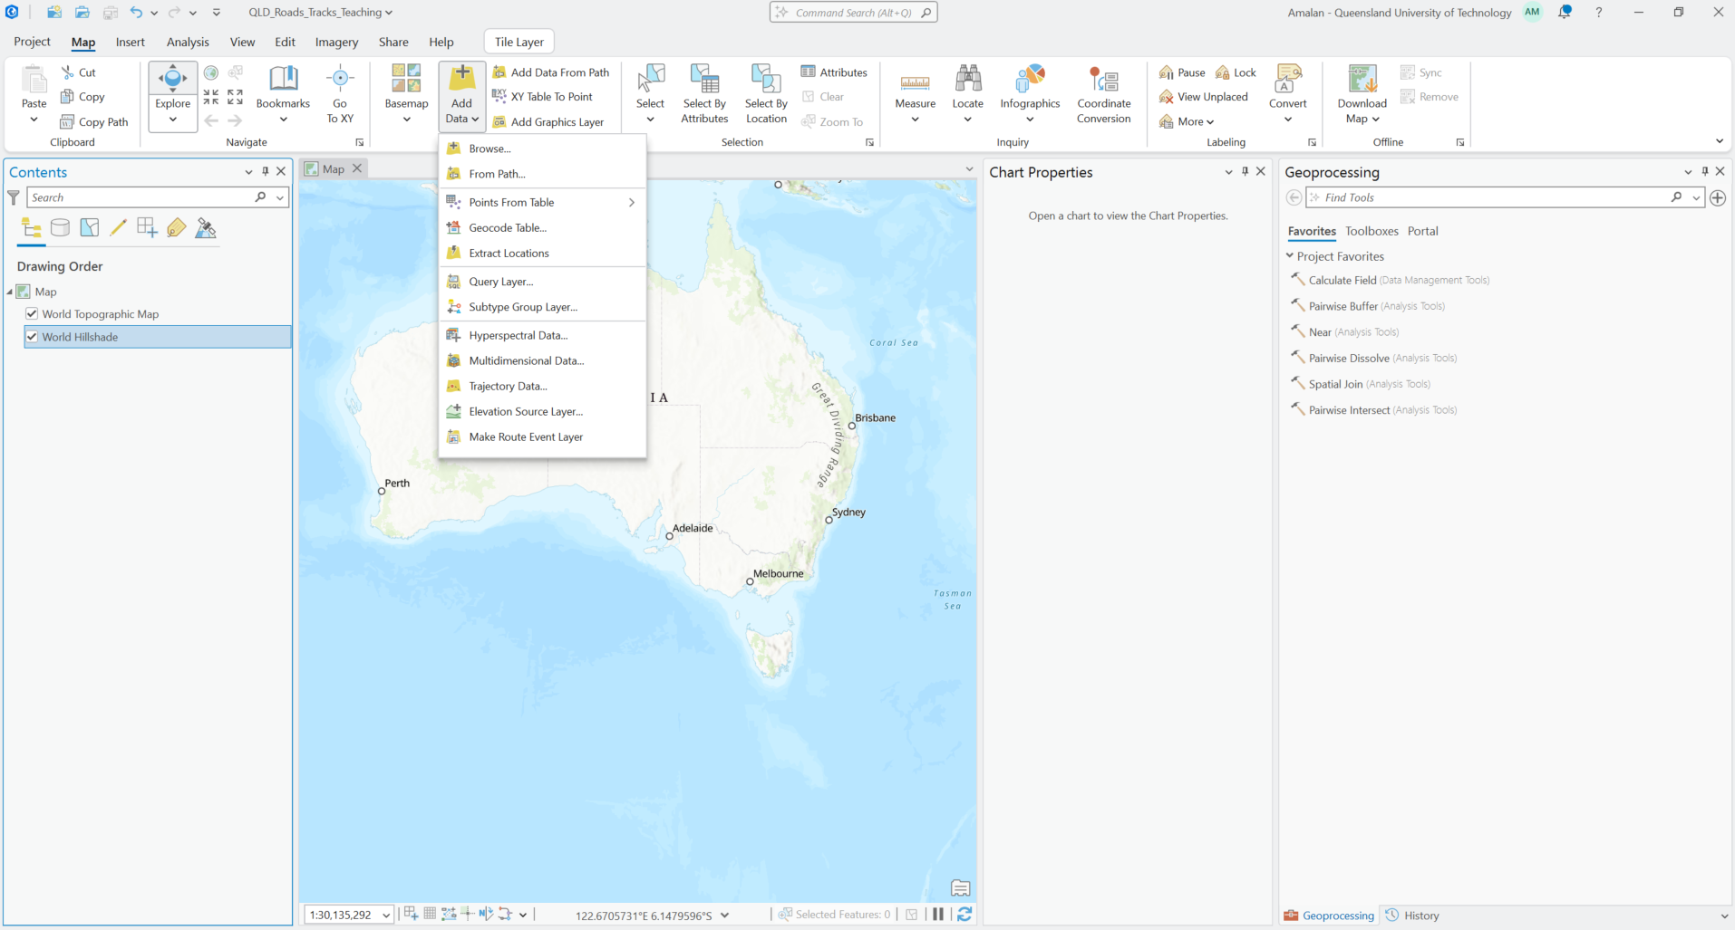
Loading data Map > Add Data > Browse

Slide 17
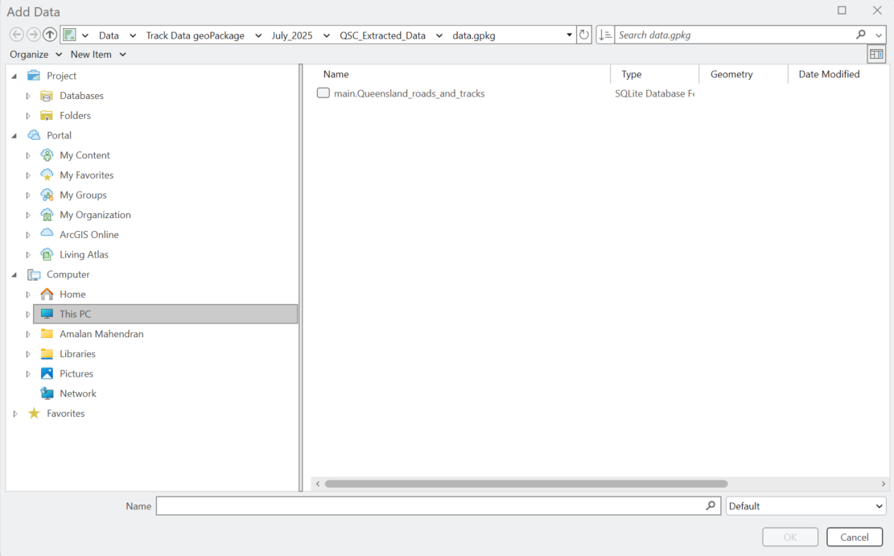
Loading Data “Select the folder” > “Select the layer”

Slide 18
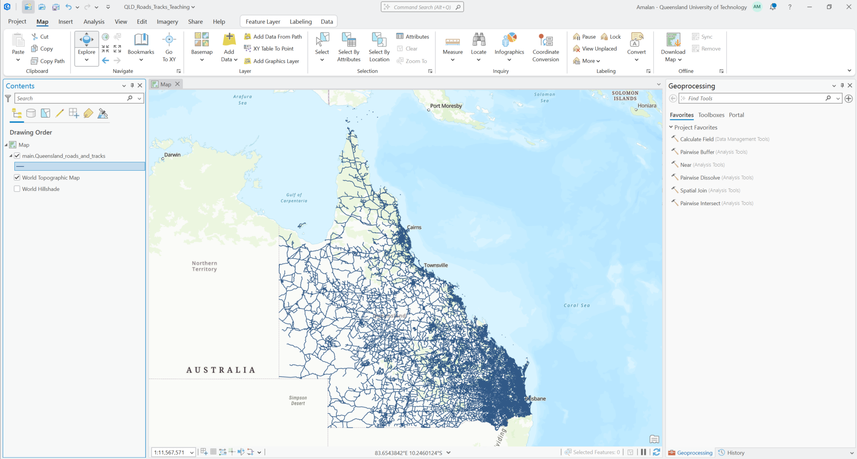
Loaded Qld roads and tracks data

Slide 19

Attribute table for Qld roads and tracks data Right click on layer > Attribute Table

Slide 20
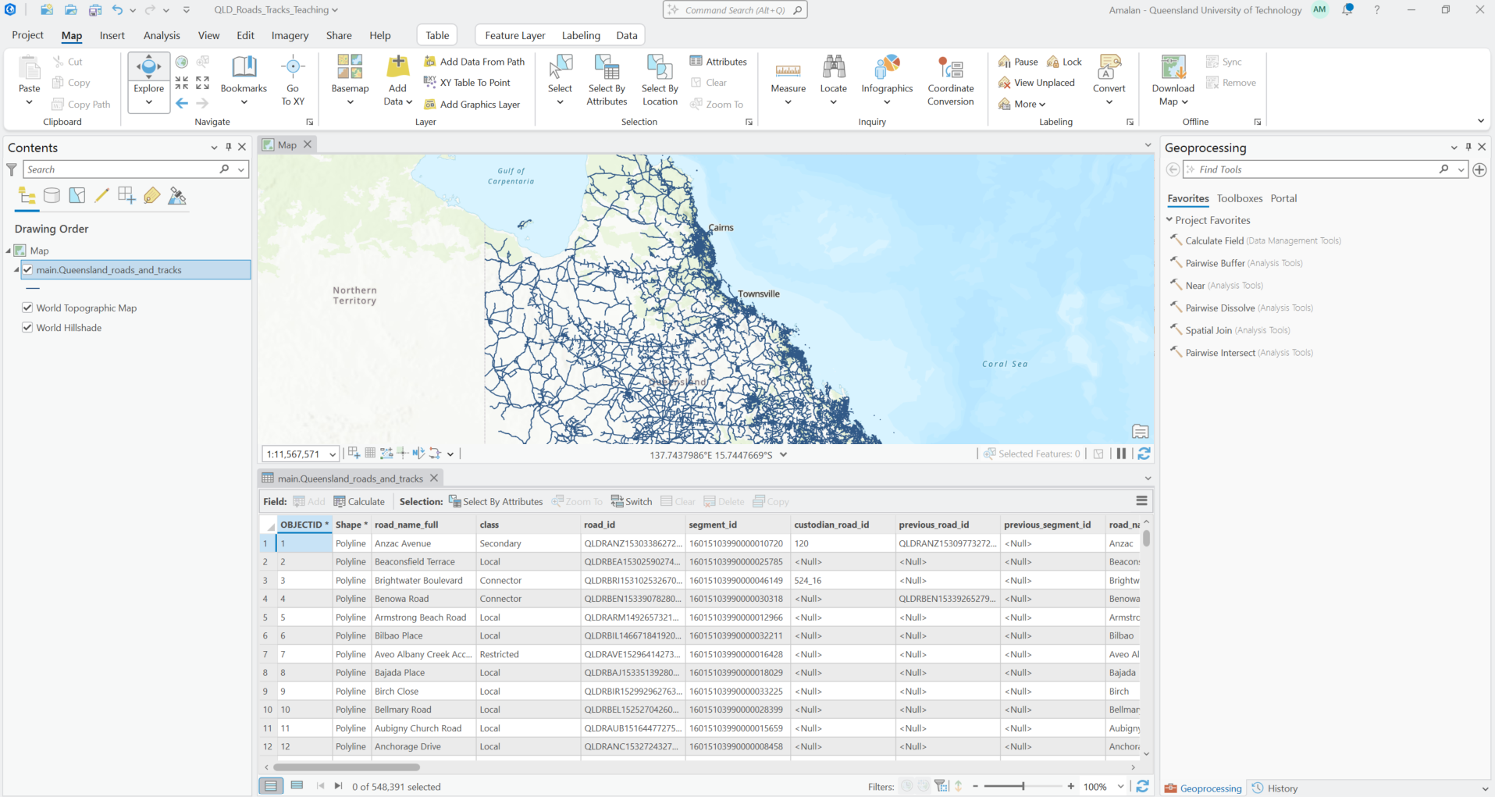
Attribute table for Qld roads and tracks data

Slide 21
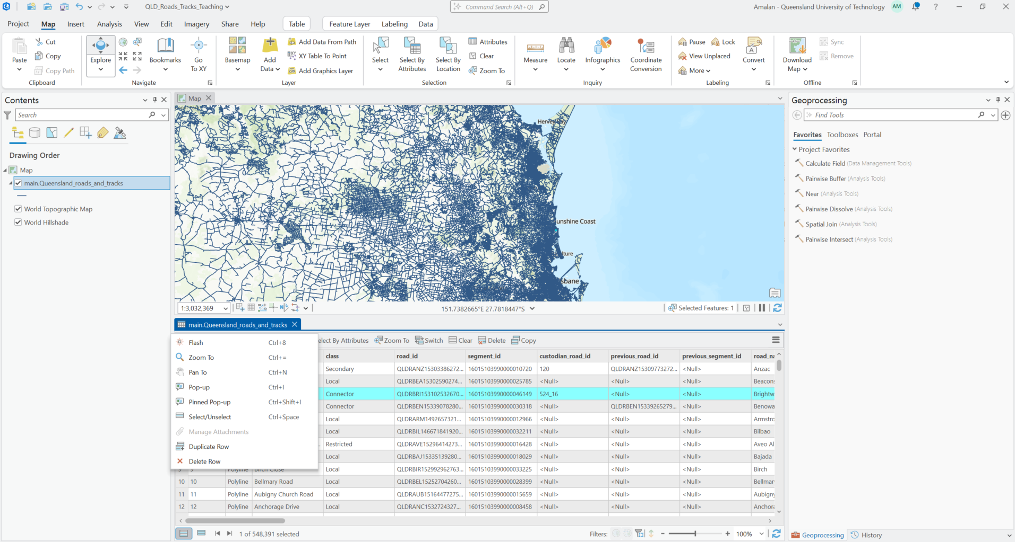
Functionality of features in the attribute table Right click on a record in attribute table

Slide 22
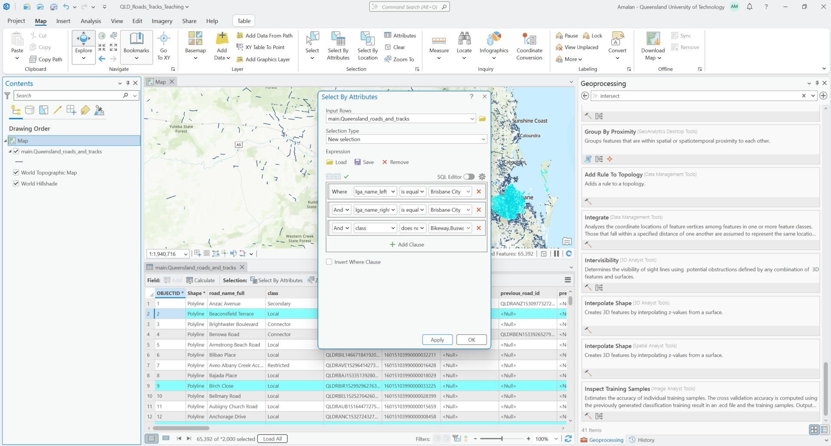
Selection/Filter/Subsetting features On the attribute table > Select “Select by Attributes

Slide 23
Selection and Filtering criteria
Selection Criteria
Local government authority is only Brisbane city
lga_left is equal “Brisbane City”
lga_right is equal “Brisbane City”
Class of vehicles
Symbol_class does not contain (“Bikeway”, “Walkway”, “Busway”, “Mall”, “Ferry”)

Slide 24
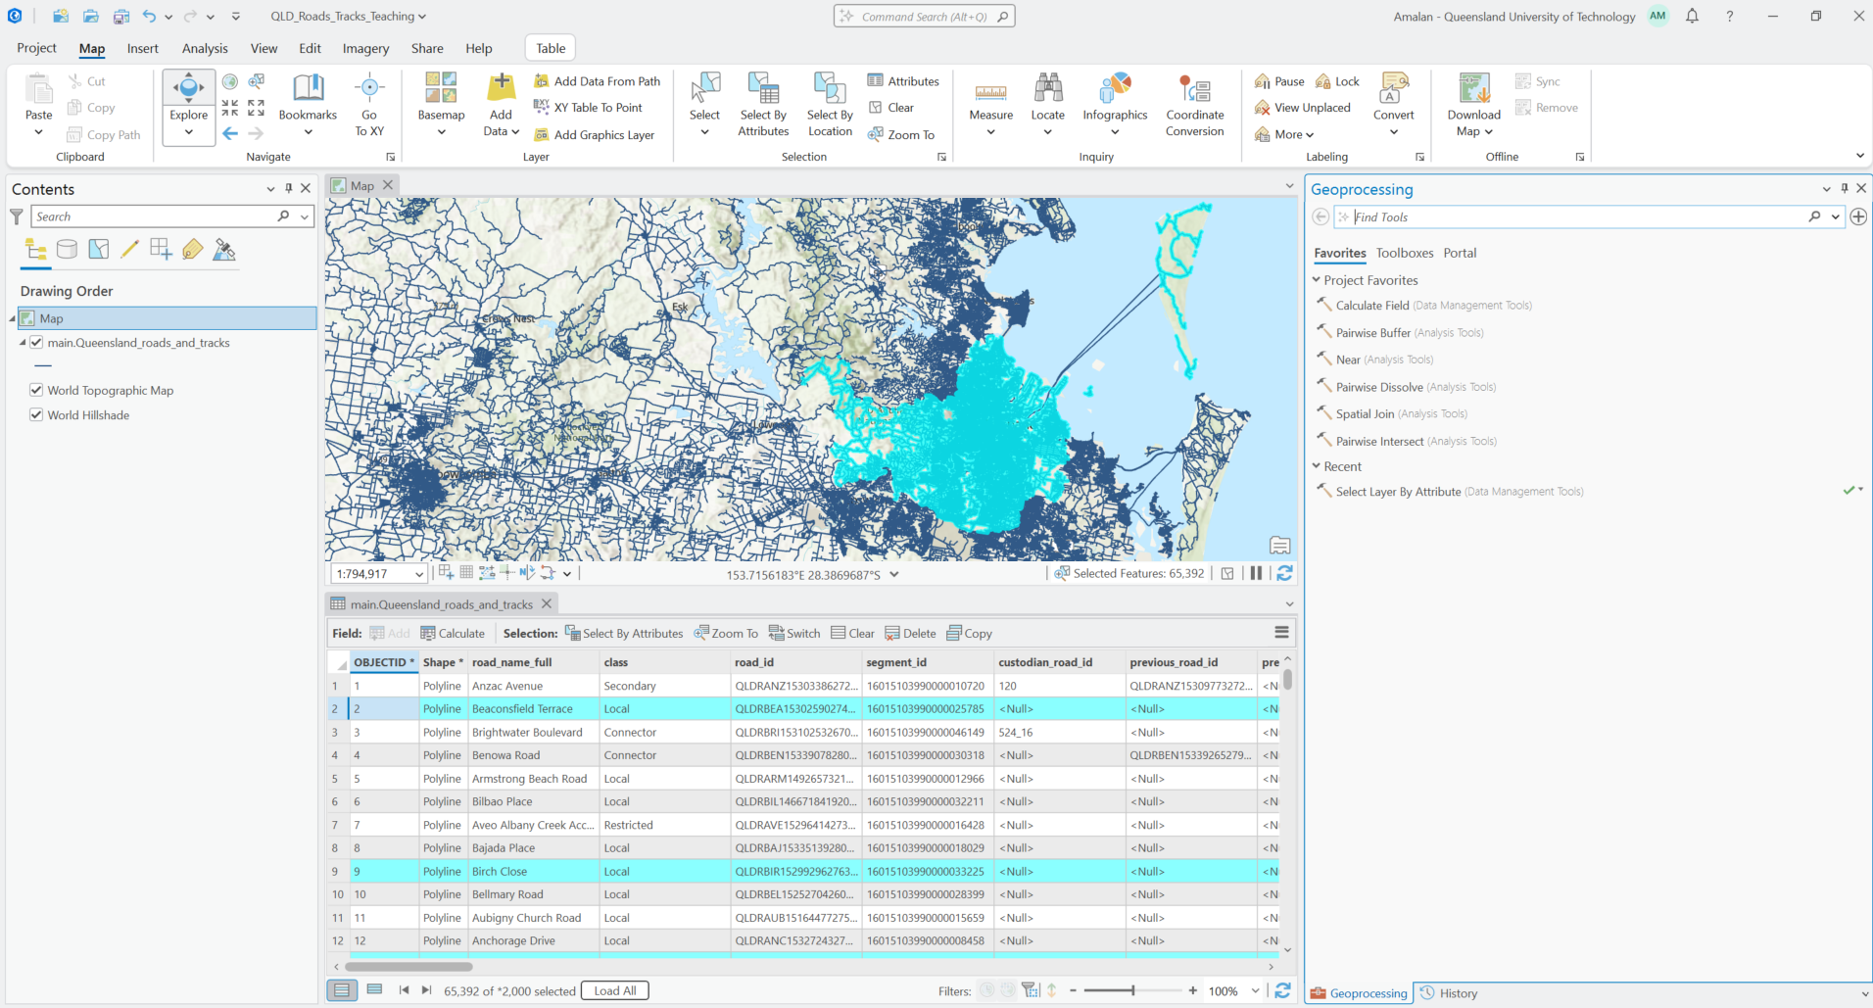
Selected links from the layer Selected features are highlighted in blue in the attribute table and in the map

Slide 25
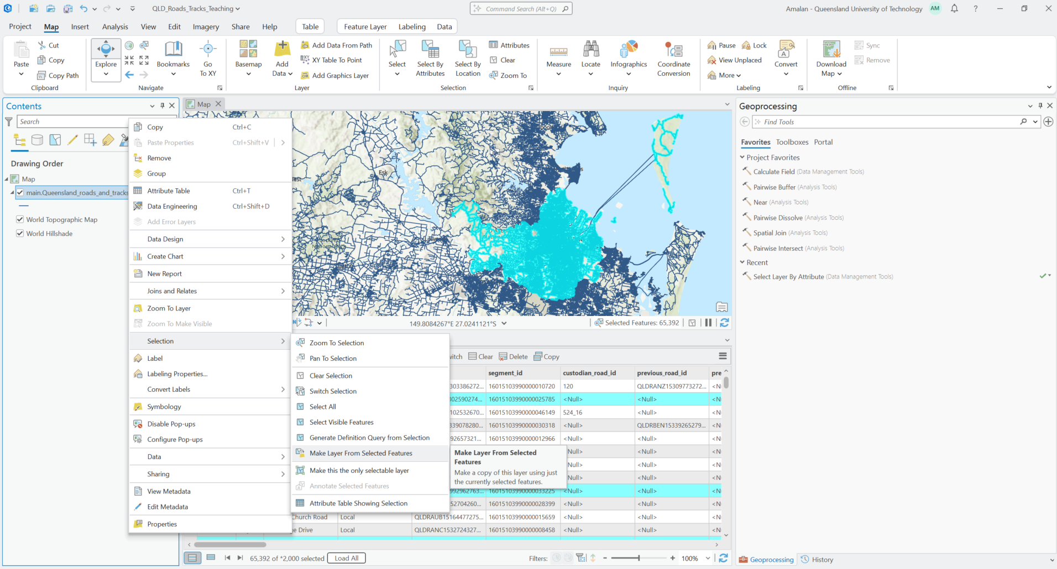
Save selected features as a layer Right click on layer after selection > Selection > Make Layer from Selected Features

Slide 26
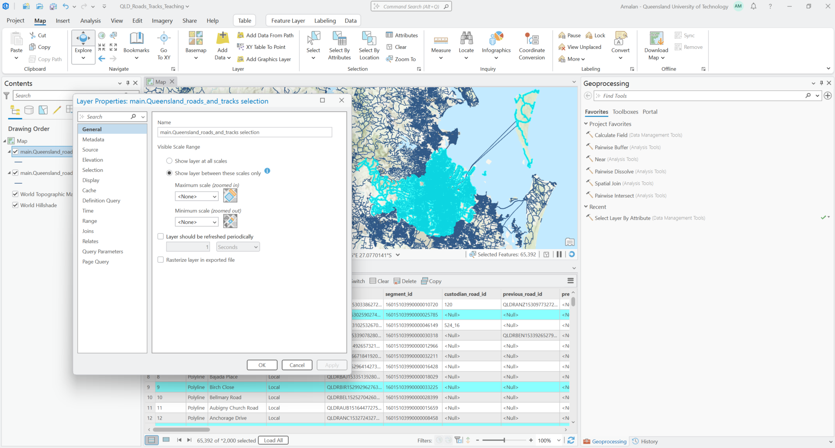
Rename the new layer Right click on layer > Properties > General > Name > rename the layer

Slide 27
Task 1 : Attribute filtering and separate layer
From the main.Queensland_roads_and_tracks map, filter the data based on the following attributes:
“lga_name_left” and “lga_name_right” is “Gold Coast city”
“class” contains “Motorway”, “Connector”, “Highway”, “Local” and “Secondary”
“road_owner” is “TMR”
Save this selection as a separate layer named “Goldcoast_City”.

Slide 28
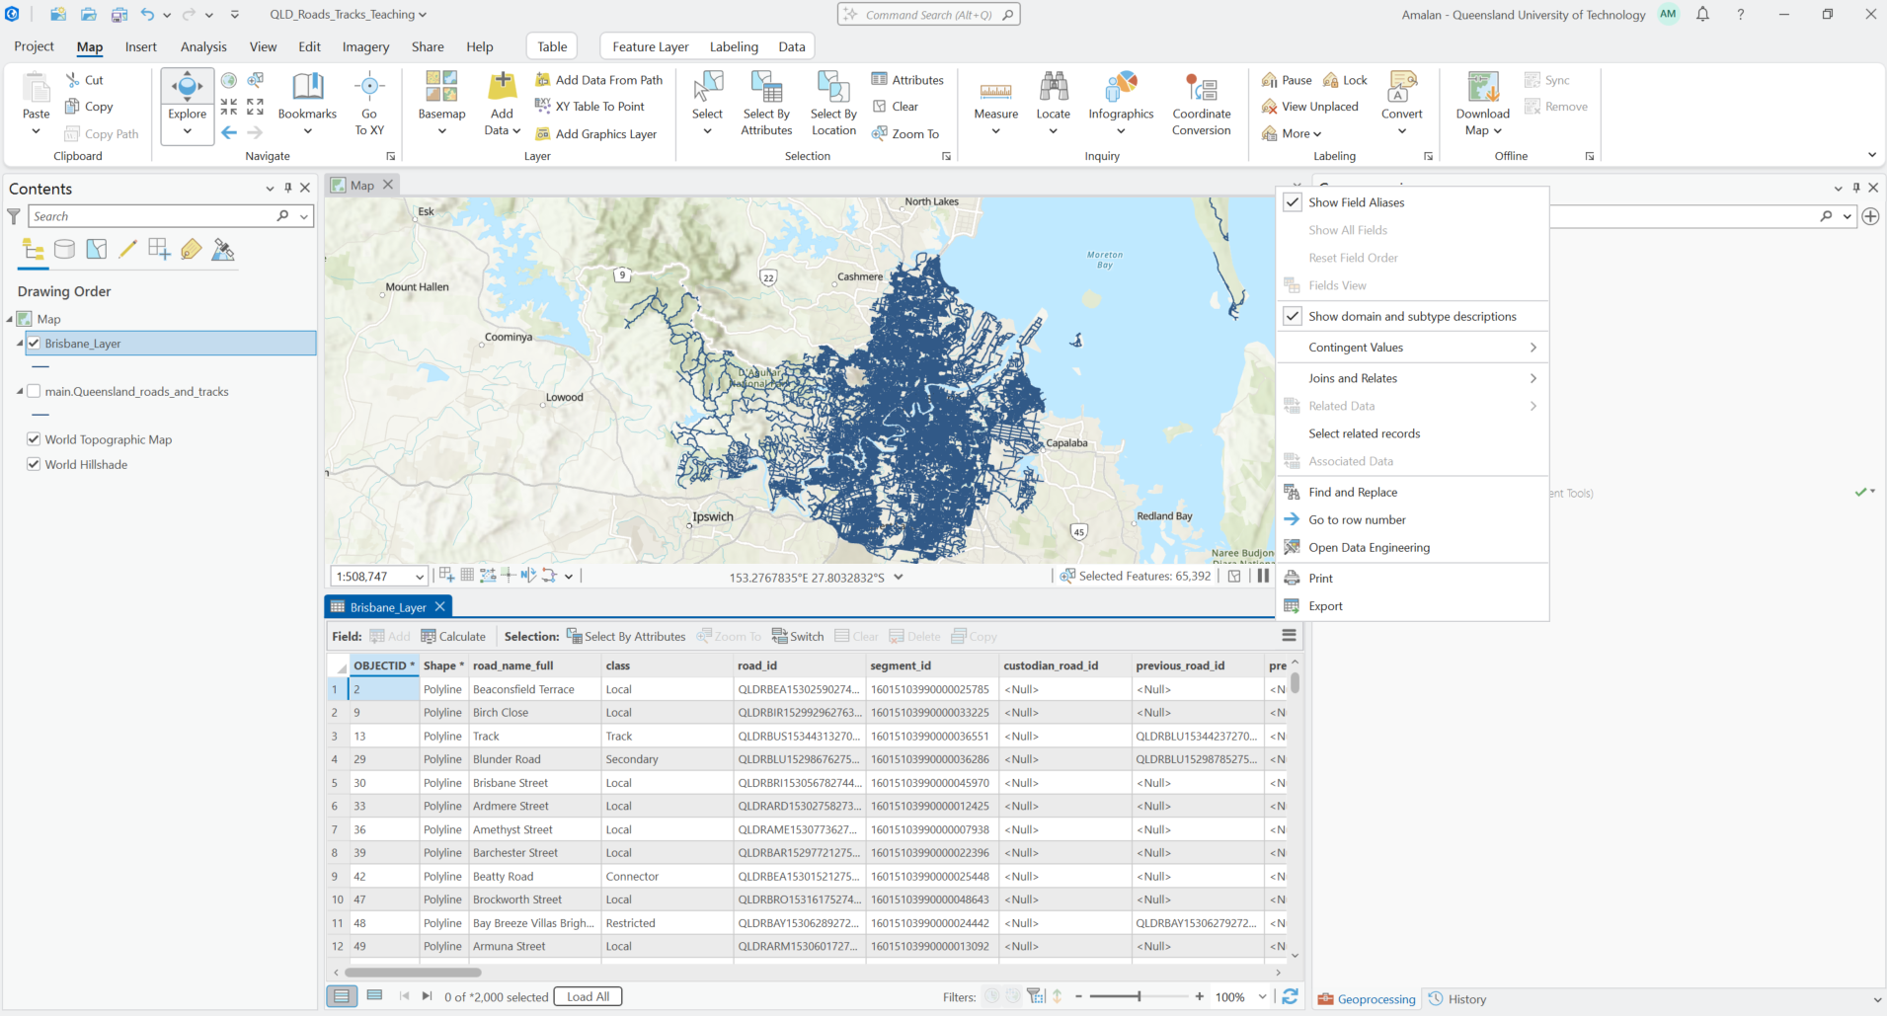
Attribute Table options In the attribute table click on the three lines on the top right corner

Slide 29
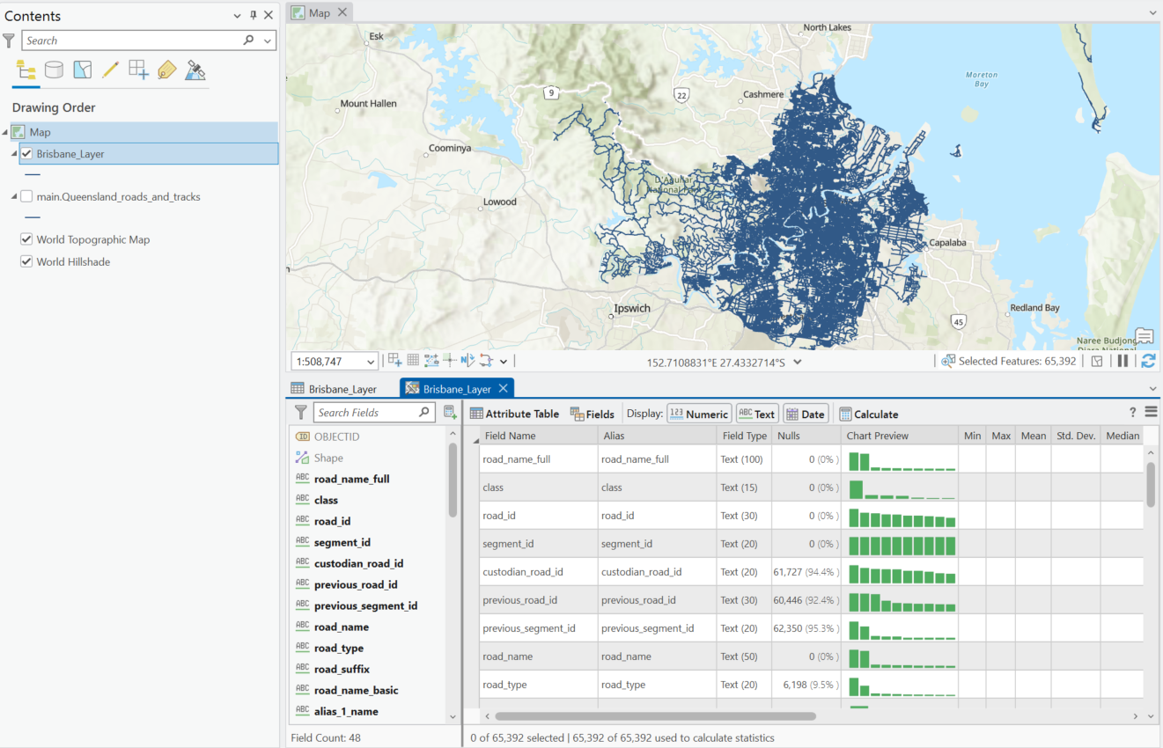
Attribute table for the selected layer In the attribute table click on the three lines on the top right corner > Select “Data Engineering”

Slide 30
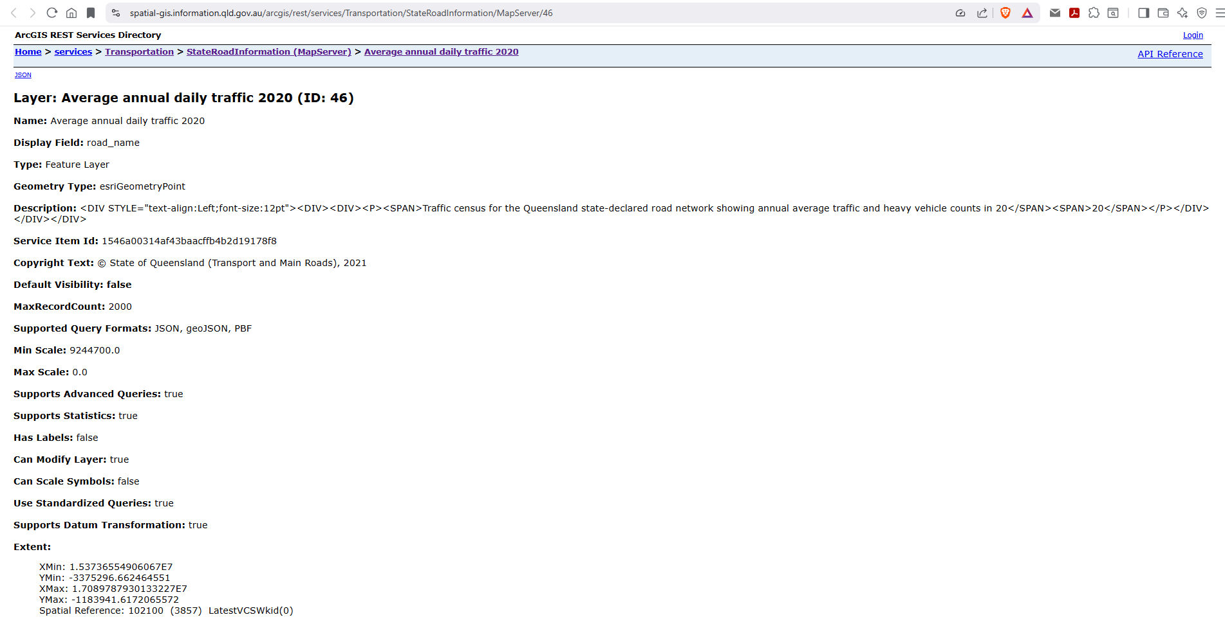
Loading Spatial Point Data (https://spatial-gis.information.qld.gov.au/arcgis/rest/services/Transportation/StateRoadInformation/MapServer/46) Paste the copied link into the path field

Slide 31
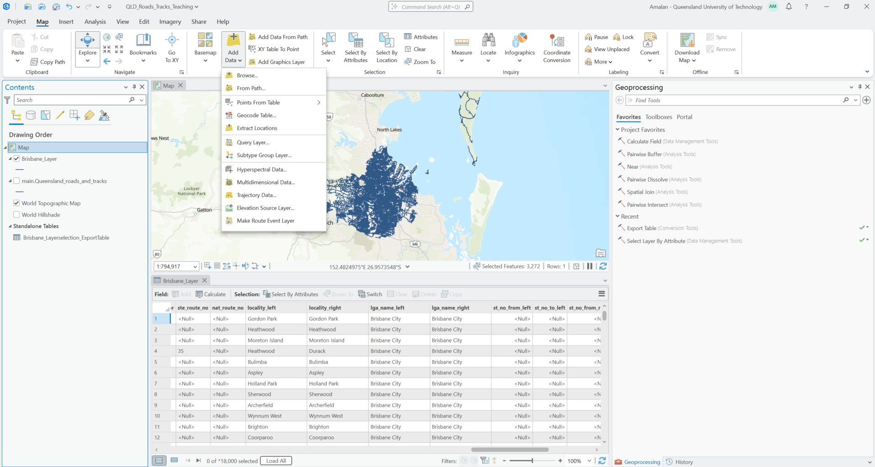
Loading spatial point data from path Map > Add Data >From path

Slide 32
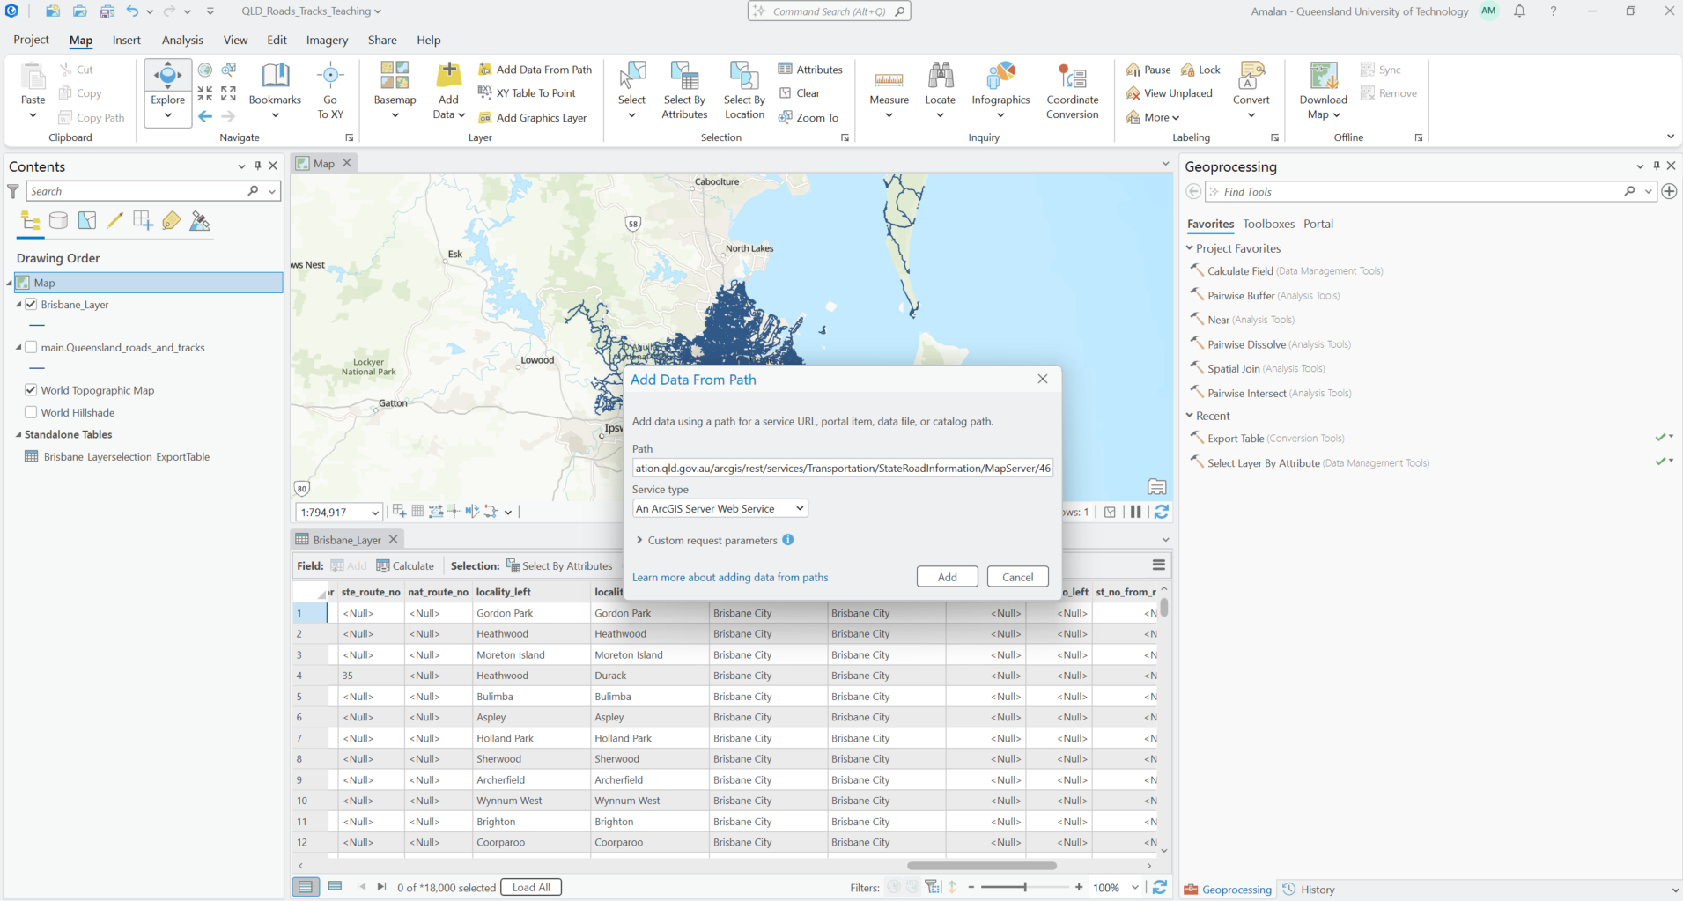
Loading spatial point data from path Copy the html link for the data > paste the link under the Path

Slide 33
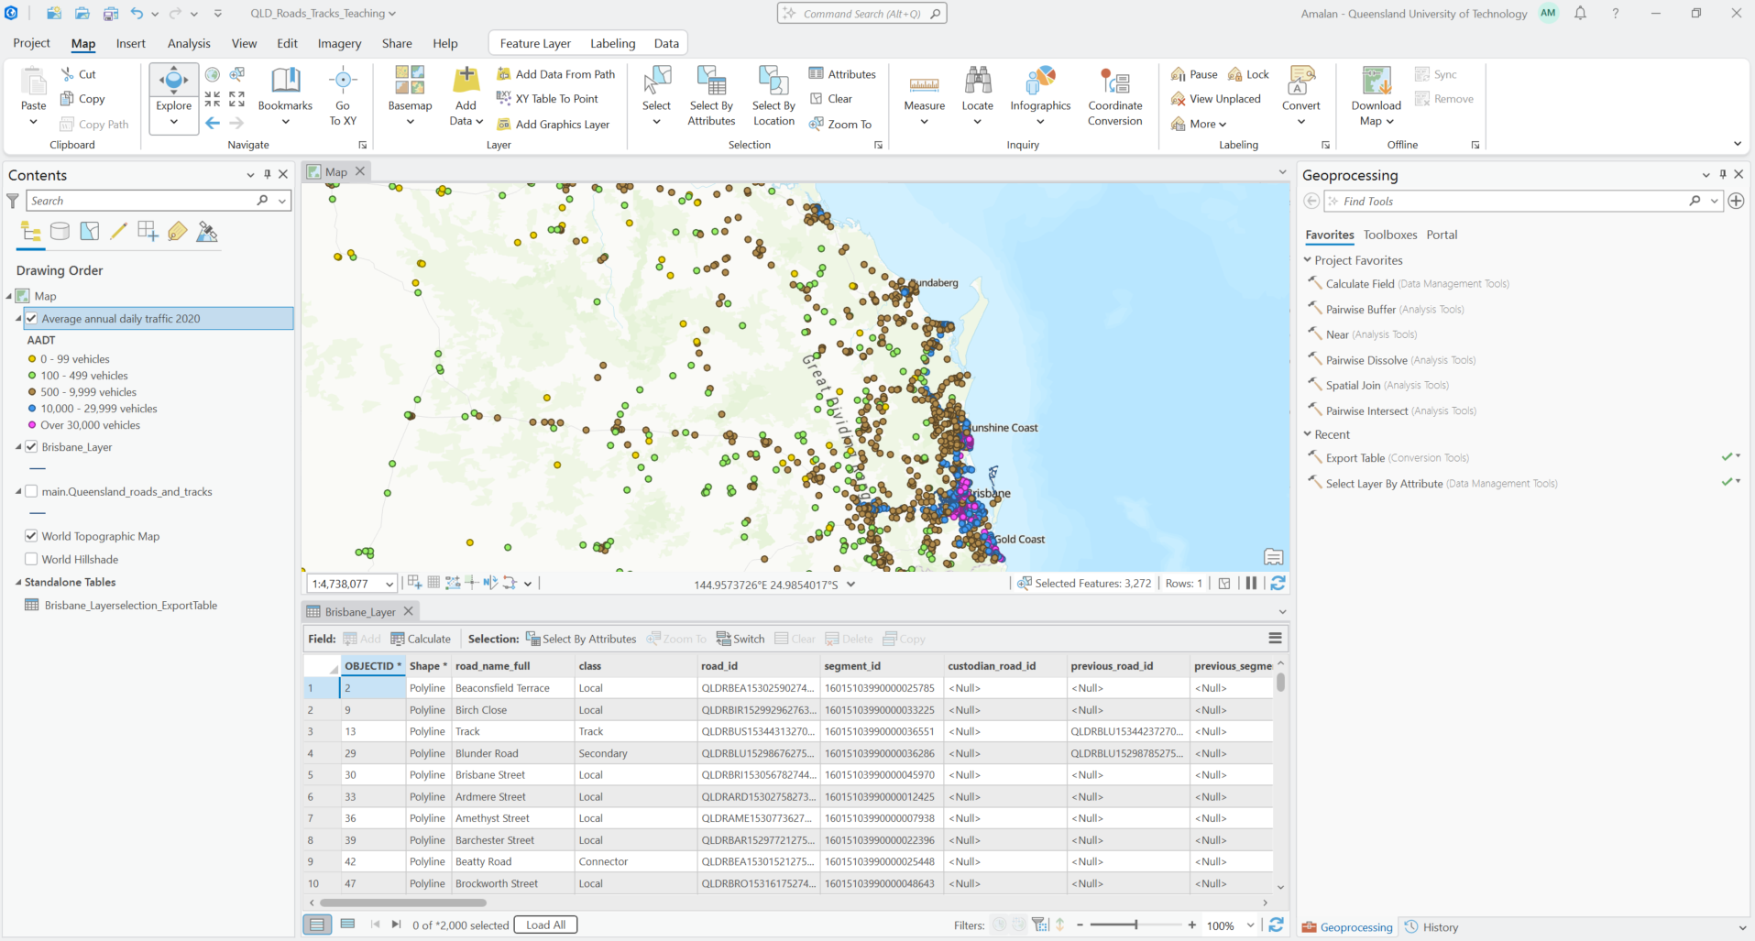
Loaded spatial point data New layer named Average annual daily traffic 2020 in the contents pane

Slide 34
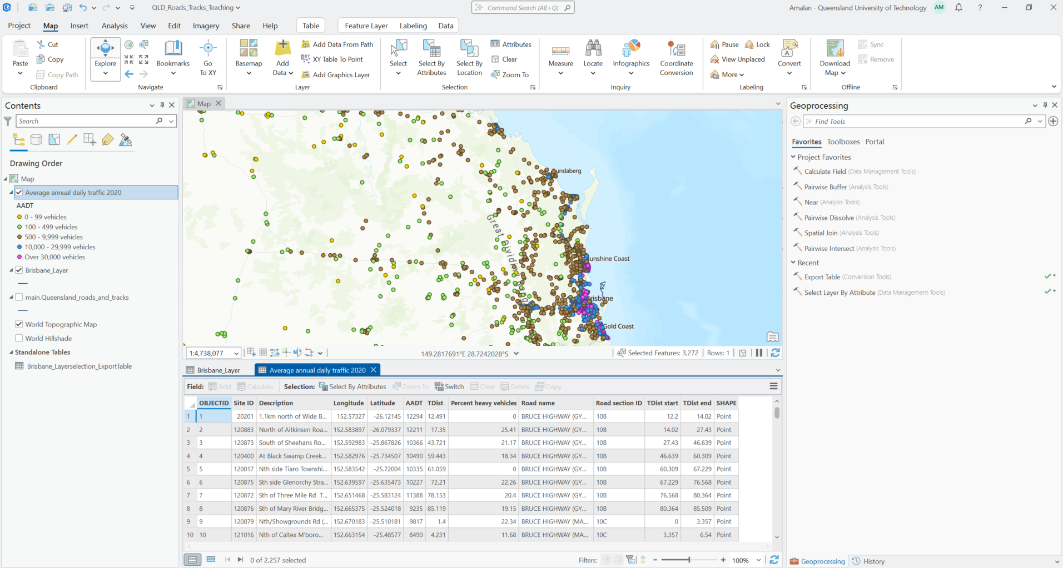
Attribute table for spatial point data Right click on spatial point layer > Attribute Table

Slide 35
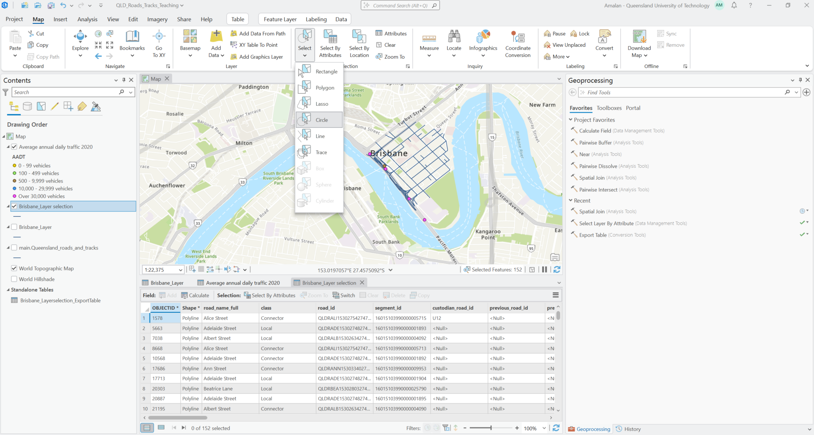
Selecting features from polyline based on select tool Map > Select > Circle > Click and drag in map to select spatial data

Slide 36
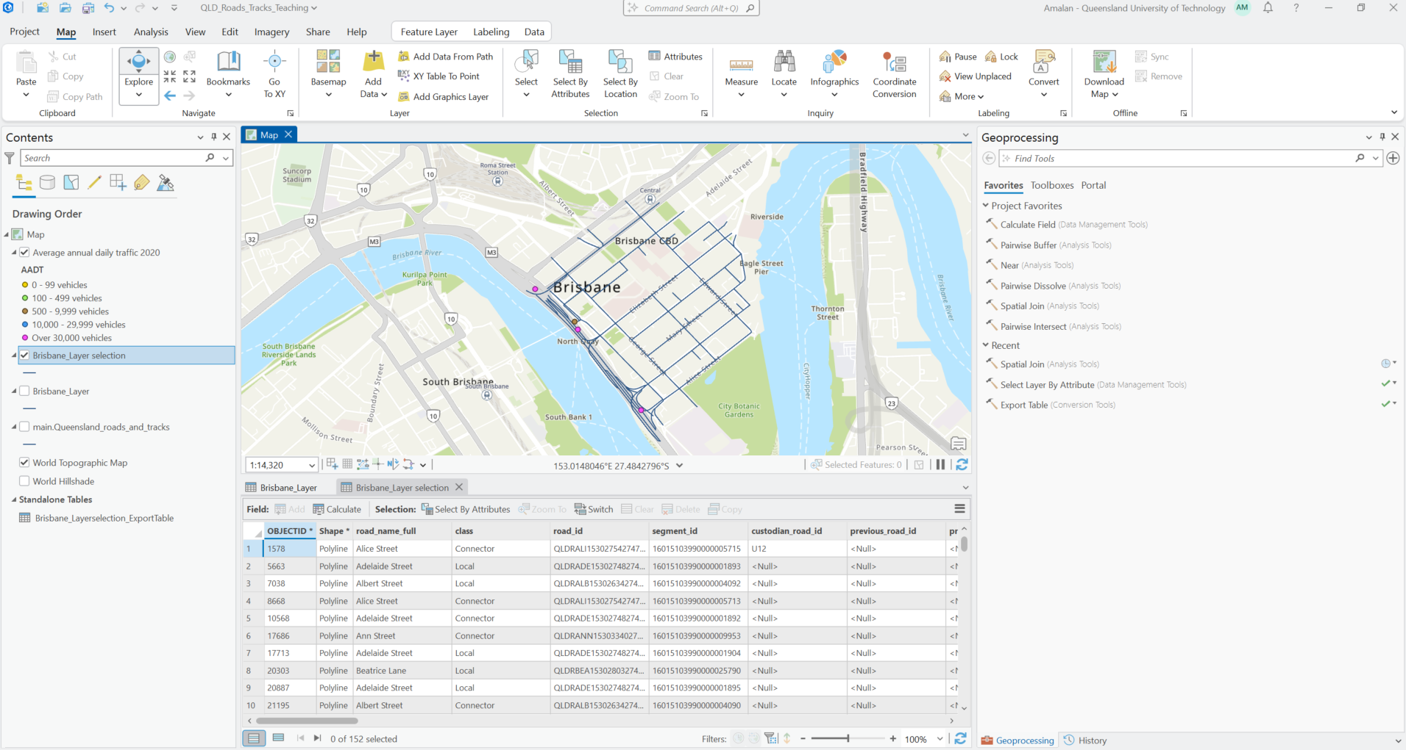
Save selected links as a separate layer From the selected features > right click on layer > selection > make layer from selected features

Slide 37
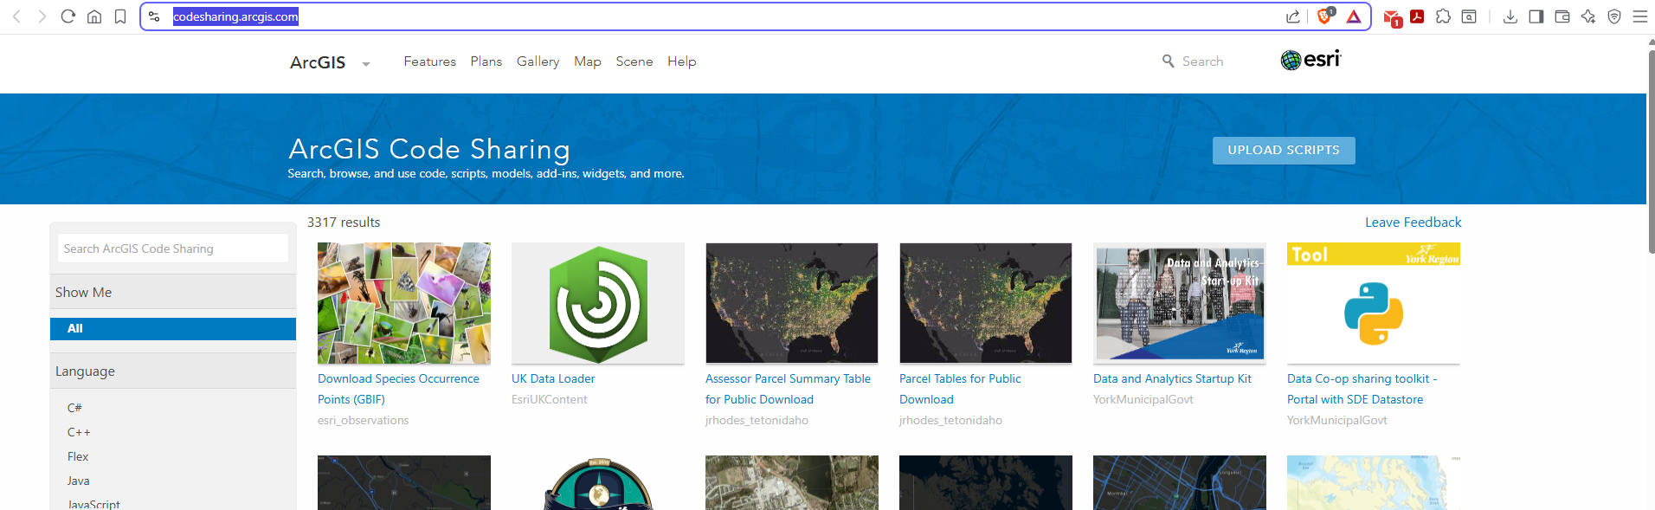
Find intersections
The standard tools in ArcGIS do not support automatic identification of intersections and their corresponding intersecting links for spatial line data.
To successfully and easily complete this task it required to download a toolbox from the ArcGIS website.
Different programming languages can be used in ArcGIS to complete tasks without difficulty and to ensure that these tools are available for everyone the “ArcGIS code sharing” website is used. (https://codesharing.arcgis.com/)
Various spatial analysts have uploaded their solutions as toolboxes to be downloaded and uploaded into the ArcGIS project.

Slide 38
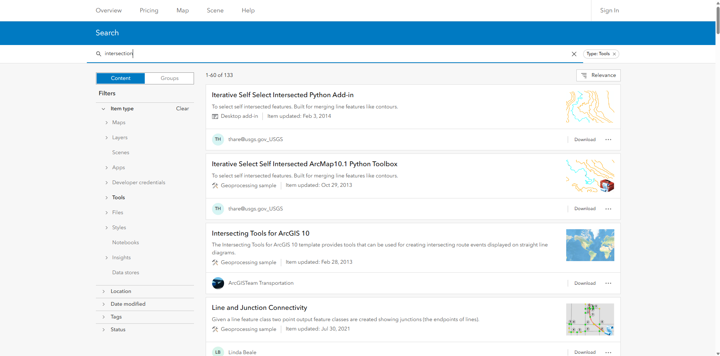
Download and Add Toolbox
In the search bar type “intersection”
Under filters select “Tools”
Run the search
From the search results read each tool and its description
Find the best tool, for our task of identifying intersections and their links the tool “Line and Junction Connectivity”
Click the download button and store the zipped folder “IntersectionCount” in your ArcGIS project folder
Go to your project folder and unzip the downloaded folder

Slide 39
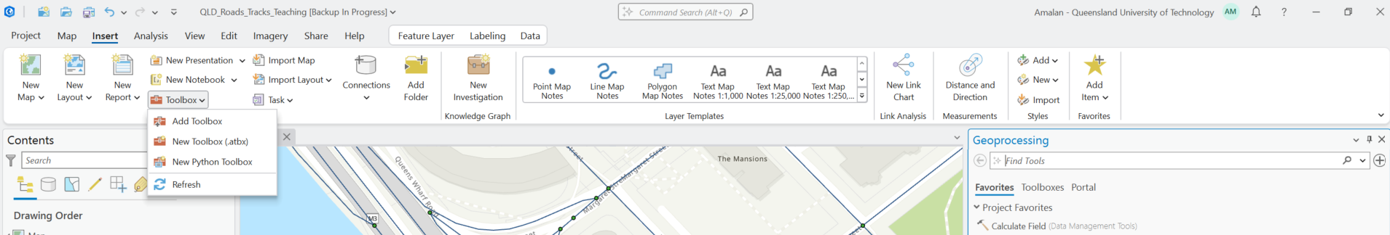
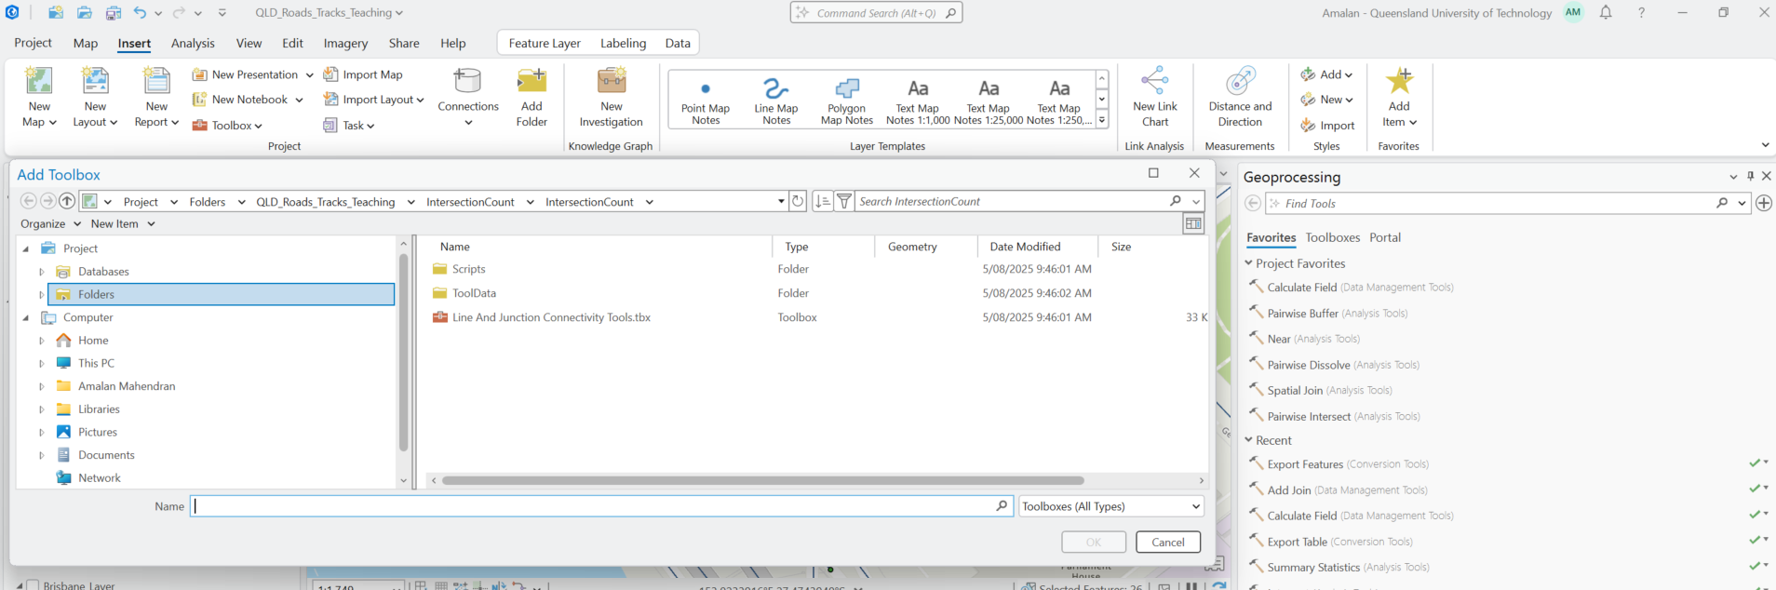
Add the “IntersectionCount” toolbox to the ArcGIS project
Toolbar > Insert > Toolbox > Add Toolbox > in the window that opens go inside the “IntersectionCount” folder and select “Line And Junction Connectivity Tools.tbx”

Slide 40
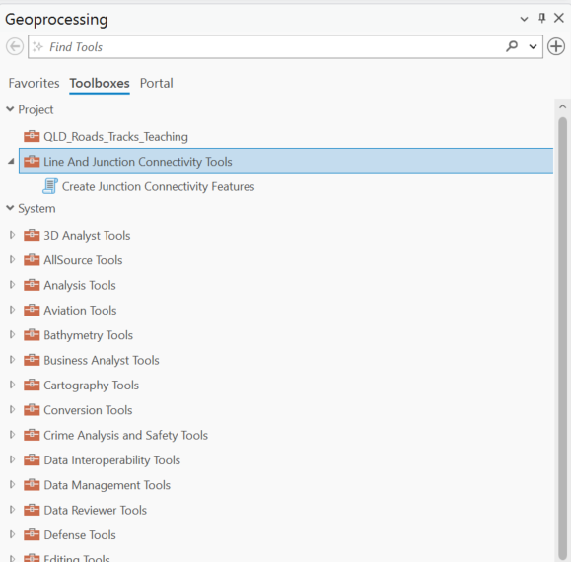
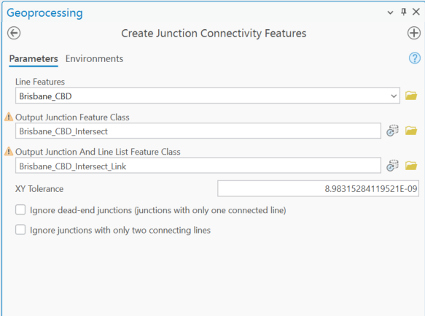
Loading “IntersectionCount” toolbox
Select Create Junction Connectivity Features
Line features : layer with line spatial data
Output Junction Feature Class and Output Junction And Line List Feature Class : layer names for the intersections (spatial point data) and links (spatial point data) of the output layers

Slide 41
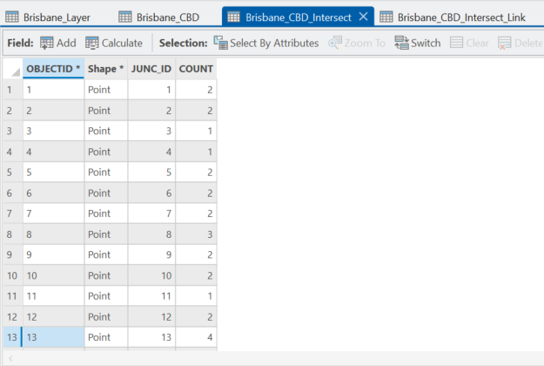
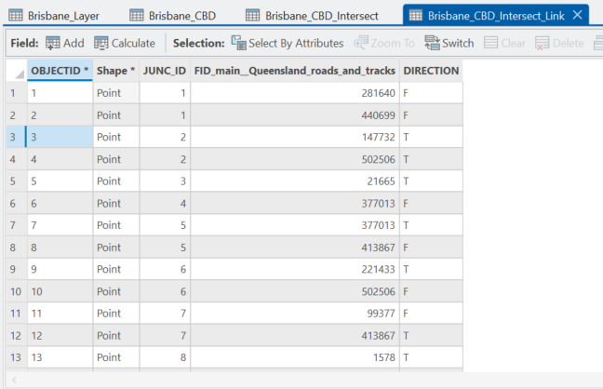
Spatial point data for the intersections.
In the attribute table “JUNC_ID” is the id assigned for the intersection automatically and “COUNT” is the number of links intersected in this intersection.
Spatial point data for the links associated with the intersections.
In the attribute table “JUNC_ID” is the id assigned for the intersection automatically, “FID_...” is the object id for the link associated with the intersection and “DIRECTION” contains a point for each line that connects to the junction and reports the direction of the line, either ‘From’ (start of the line) or ‘To’ (end of the line).

Slide 42
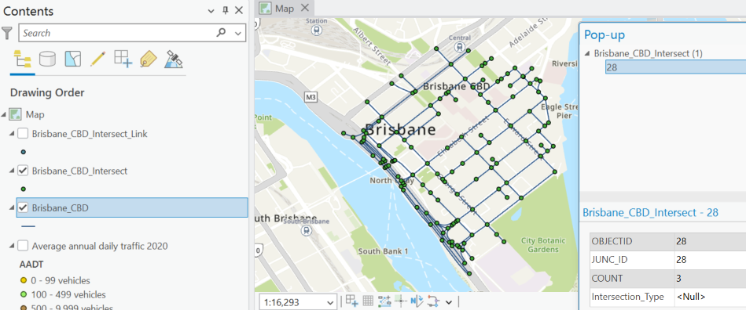
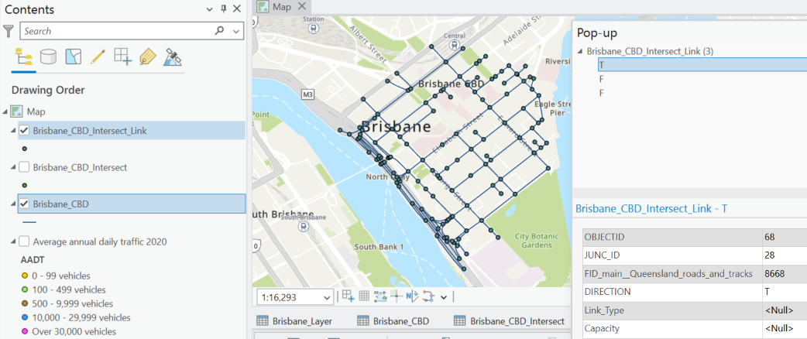
Spatial point data for the intersections.
Spatial point data for the links associated with the intersections.

Slide 43
Task 2: For the selected “Goldcoast City” layer find intersections and their respective links
For the “Goldcoast City” layer, zoom in, use the circle selection tool, and export the selected features as a separate layer.
Then, find the intersection points using the “IntersectionCount” toolbox.
Obtain the two output layers for the intersection and the links associated with the intersections.

Slide 44
For a selected Intersection (node) identify the intersection type from reality (google maps) and store the information
Add a new field named Intersection_Type to the Brisbane_CBD_Intersect attribute table. Set the data type to Text, and save the changes by right-clicking on Fields: Brisbane_CBD_Intersect.
From the “Brisbane_CBD_Intersect” attribute table select an intersection by id (JUNC_ID is 1) and right click on the record and select “Flash”.
Navigate to the flashing intersection on the map and right click on the intersection point in the map and select “Copy Coordinates”.
Open a web browser, go to “https://www.google.com/maps” and paste the copied coordinates in the search bar and go to the location. Open Street View using the icon in the bottom right corner of the google map.
From the street view point of view gather relevant information for the intersection, here it would be the Intersection type and record it in the “Brisbane_CBD_Intersect” layer attribute table under “Intersection_Type”.
If additional information needs to be recorded for the intersections, based on the information add a field to the “Brisbane_CBD_Intersect” layer and repeat steps from 2 to 5 until all intersections are populated.

Slide 45
For a selected Intersection (node) identify the intersection type from reality (google maps) and store the information
Add a new field named Intersection_Type to the Brisbane_CBD_Intersect attribute table. Set the data type to Text, and save the changes by right-clicking on Fields: Brisbane_CBD_Intersect.
From the “Brisbane_CBD_Intersect” attribute table select an intersection by id (JUNC_ID is 1) and right click on the record and select “Flash”.
Navigate to the flashing intersection on the map and right click on the intersection point in the map and select “Copy Coordinates”.
Open a web browser, go to “https://www.google.com/maps” and paste the copied coordinates in the search bar and go to the location. Open Street View using the icon in the bottom right corner of the google map.
From the street view point of view gather relevant information for the intersection, here it would be the Intersection type and record it in the “Brisbane_CBD_Intersect” layer attribute table under “Intersection_Type”.
If additional information needs to be recorded for the intersections, based on the information add a field to the “Brisbane_CBD_Intersect” layer and repeat steps from 2 to 5 until all intersections are populated.

Slide 46
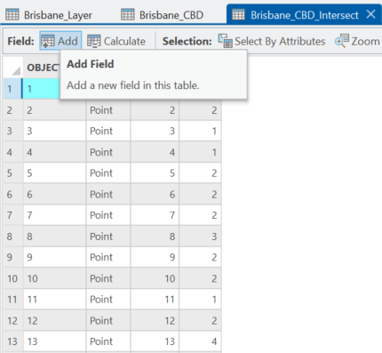
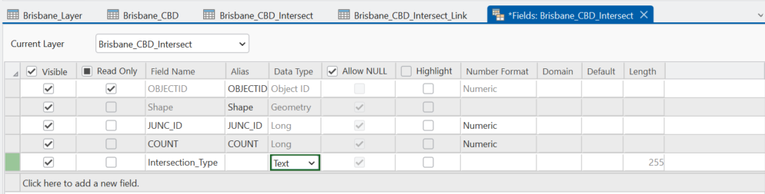
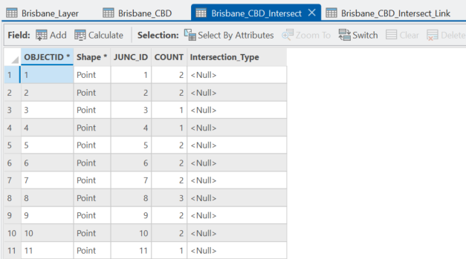
Add field “Intersection_Type” > For “Brisbane_CBD_Intersect” attribute table > Add > In “Fields: Brisbane_CBD_Intersect” > set “Field Name: Intersection_Type” > set “Data_Type : Text” from drop down list > Right click on “Fields: Brisbane_CBD_Intersect” and save

Slide 47
For a selected Intersection (node) identify the intersection type from reality (google maps) and store the information
Add a new field named Intersection_Type to the Brisbane_CBD_Intersect attribute table. Set the data type to Text, and save the changes by right-clicking on Fields: Brisbane_CBD_Intersect.
From the “Brisbane_CBD_Intersect” attribute table select an intersection by id (JUNC_ID is 1) and right click on the record and select “Flash”.
Navigate to the flashing intersection on the map and right click on the intersection point in the map and select “Copy Coordinates”.
Open a web browser, go to “https://www.google.com/maps” and paste the copied coordinates in the search bar and go to the location. Open Street View using the icon in the bottom right corner of the google map.
From the street view point of view gather relevant information for the intersection, here it would be the Intersection type and record it in the “Brisbane_CBD_Intersect” layer attribute table under “Intersection_Type”.
If additional information needs to be recorded for the intersections, based on the information add a field to the “Brisbane_CBD_Intersect” layer and repeat steps from 2 to 5 until all intersections are populated.

Slide 48
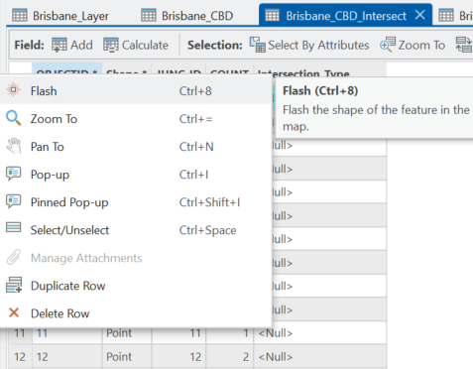
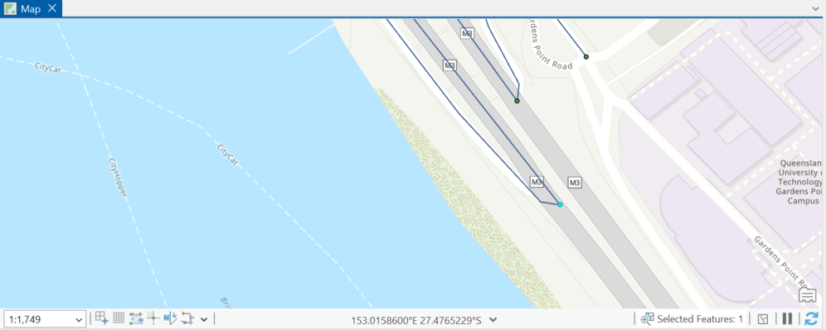
In “Brisbane_CBD_Intersect” attribute table select feature JUNC_ID is 1 and right click on the record and select “Flash”.

Slide 49
For a selected Intersection (node) identify the intersection type from reality (google maps) and store the information
Add a new field named Intersection_Type to the Brisbane_CBD_Intersect attribute table. Set the data type to Text, and save the changes by right-clicking on Fields: Brisbane_CBD_Intersect.
From the “Brisbane_CBD_Intersect” attribute table select an intersection by id (JUNC_ID is 1) and right click on the record and select “Flash”.
Navigate to the flashing intersection on the map and right click on the intersection point in the map and select “Copy Coordinates”.
Open a web browser, go to “https://www.google.com/maps” and paste the copied coordinates in the search bar and go to the location. Open Street View using the icon in the bottom right corner of the google map.
From the street view point of view gather relevant information for the intersection, here it would be the Intersection type and record it in the “Brisbane_CBD_Intersect” layer attribute table under “Intersection_Type”.
If additional information needs to be recorded for the intersections, based on the information add a field to the “Brisbane_CBD_Intersect” layer and repeat steps from 2 to 5 until all intersections are populated.

Slide 50
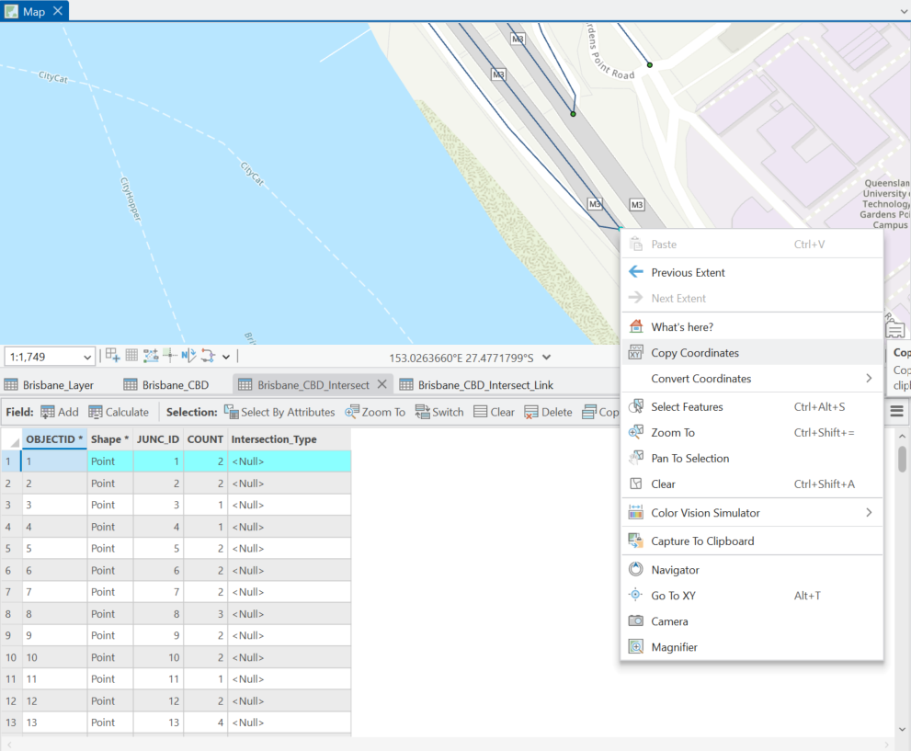
Go to the flashing intersection in the map and right click on the intersection point in the map and select “Copy Coordinates”.
The copied coordinates : 153.0263827°E 27.4771771°S

Slide 51
For a selected Intersection (node) identify the intersection type from reality (google maps) and store the information
Add a new field named Intersection_Type to the Brisbane_CBD_Intersect attribute table. Set the data type to Text, and save the changes by right-clicking on Fields: Brisbane_CBD_Intersect.
From the “Brisbane_CBD_Intersect” attribute table select an intersection by id (JUNC_ID is 1) and right click on the record and select “Flash”.
Navigate to the flashing intersection on the map and right click on the intersection point in the map and select “Copy Coordinates”.
Open a web browser, go to “https://www.google.com/maps” and paste the copied coordinates in the search bar and go to the location. Open Street View using the icon in the bottom right corner of the google map.
From the street view point of view gather relevant information for the intersection, here it would be the Intersection type and record it in the “Brisbane_CBD_Intersect” layer attribute table under “Intersection_Type”.
If additional information needs to be recorded for the intersections, based on the information add a field to the “Brisbane_CBD_Intersect” layer and repeat steps from 2 to 5 until all intersections are populated.

Slide 52
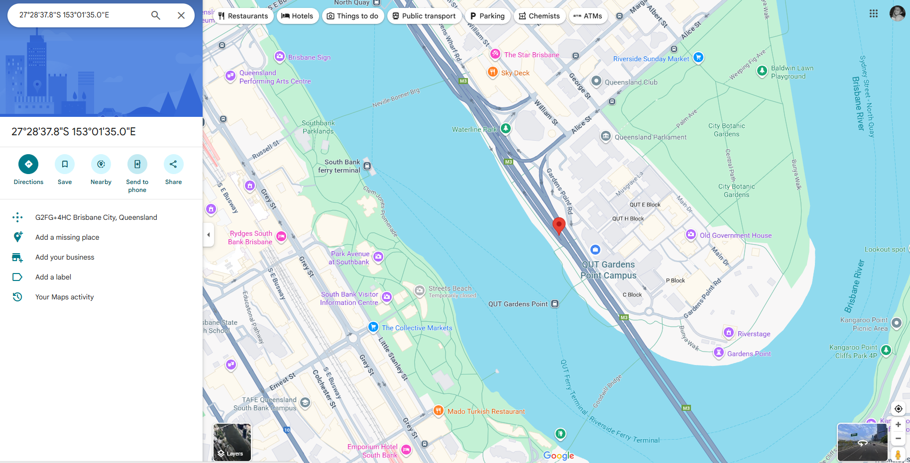
Open a web browser, go to google.maps and paste the copied coordinates in the search bar and select the street view window in the bottom right corner of the google map

Slide 53
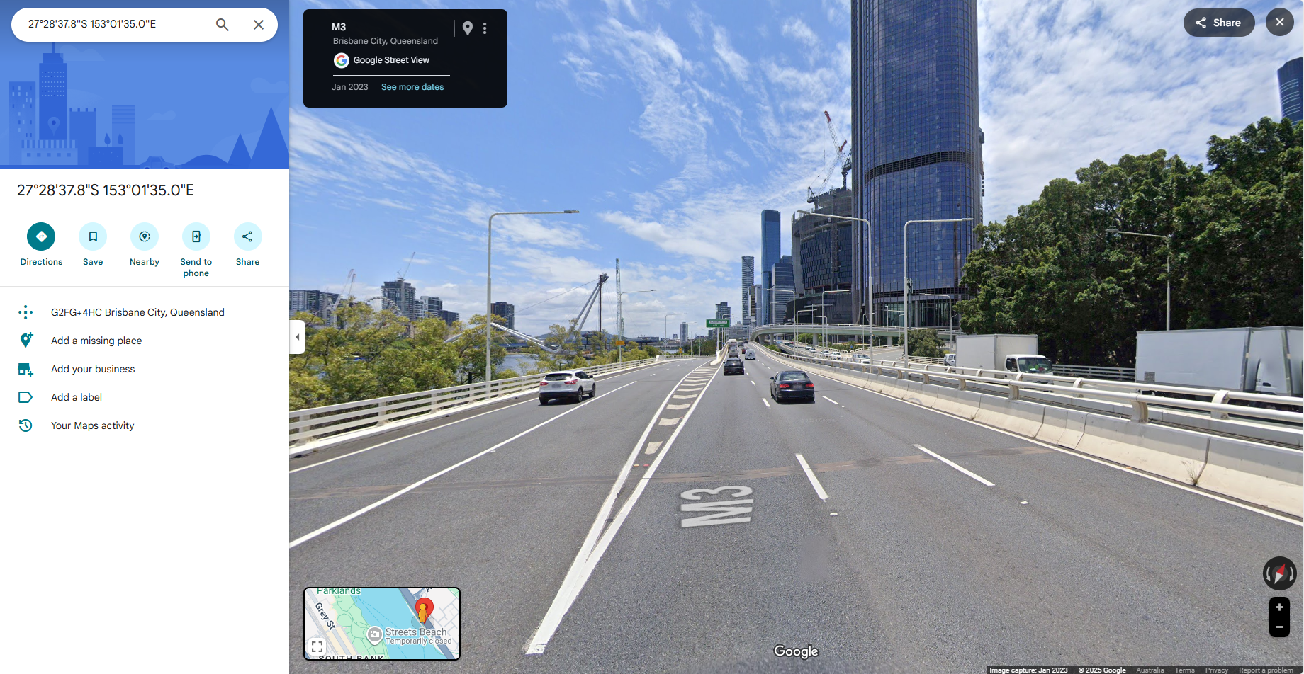
Open a web browser, go to google.maps and paste the copied coordinates in the search bar and select the street view window in the bottom right corner of the google map

Slide 54
For a selected Intersection (node) identify the intersection type from reality (google maps) and store the information
Add a new field named Intersection_Type to the Brisbane_CBD_Intersect attribute table. Set the data type to Text, and save the changes by right-clicking on Fields: Brisbane_CBD_Intersect.
From the “Brisbane_CBD_Intersect” attribute table select an intersection by id (JUNC_ID is 1) and right click on the record and select “Flash”.
Navigate to the flashing intersection on the map and right click on the intersection point in the map and select “Copy Coordinates”.
Open a web browser, go to “https://www.google.com/maps” and paste the copied coordinates in the search bar and go to the location. Open Street View using the icon in the bottom right corner of the google map.
From the street view point of view gather relevant information for the intersection, here it would be the Intersection type and record it in the “Brisbane_CBD_Intersect” layer attribute table under “Intersection_Type”.
If additional information needs to be recorded for the intersections, based on the information add a field to the “Brisbane_CBD_Intersect” layer and repeat steps from 2 to 5 until all intersections are populated.

Slide 55
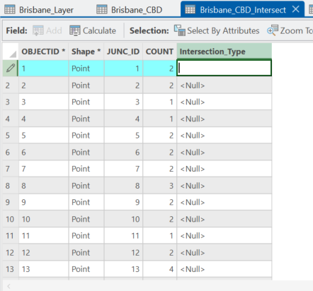
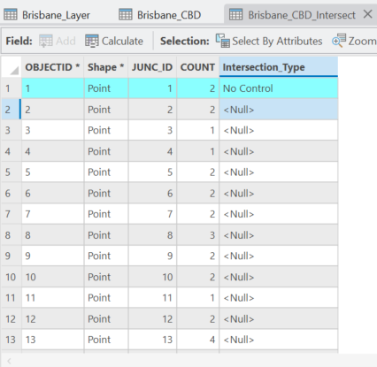
From the street view gather relevant information for the intersection and record it in the attribute table of “Brisbane_CBD_Intersect” layer > Double click on cell adjacent to the relevant JUNC_ID is 1 under the field Intersection_Type and type “No Control” and save the ArcGIS project (Ctrl + S)

Slide 56
For a selected Intersection (node) identify the links associated from reality (google maps) and store the information
Add the field “Link_Type” and “Capcity” in the “Brisbane_CBD_Intersect_Link” attribute table, assign data type to be “Text” and “Long”, respectively, save the changes by right clicking on the “Fields:Brisbane_CBD_Intersect_Link”.
From the “Brisbane_CBD_Intersect_Link” attribute table select an intersection by id (JUNC_ID is 1 and FID is 281460) and right click on the record and select “Flash”.
Navigate to the flashing intersection on the map and click on the intersection links in the map.
Among the intersected links, click each one to identify the correct one by FID.
Right click on the intersection point in the map and select “Copy Coordinates”. Open a web browser, go to “https://www.google.com/maps” and paste the copied coordinates in the search bar and go to the location, select the street view window in the bottom right corner of the google map.
Based on the FID and the link in the map collect the information for “Link_Type” and “Capacity” and record it in the “Brisbane_CBD_Intersect_Link” layer attribute table under “Link_Type” and “Capacity”, respectively.
If additional information needs to be recorded for the links in the intersections, based on the information add a field to the “Brisbane_CBD_Intersect_Link” layer and repeat steps from 2 to 6 until all intersection links are populated.

Slide 57
For a selected Intersection (node) identify the links associated from reality (google maps) and store the information
Add the field “Link_Type” and “Capcity” in the “Brisbane_CBD_Intersect_Link” attribute table, assign data type to be “Text” and “Long”, respectively, save the changes by right clicking on the “Fields:Brisbane_CBD_Intersect_Link”.
From the “Brisbane_CBD_Intersect_Link” attribute table select an intersection by id (JUNC_ID is 1 and FID is 281460) and right click on the record and select “Flash”.
Navigate to the flashing intersection on the map and click on the intersection links in the map.
Among the intersected links, click each one to identify the correct one by FID.
Right click on the intersection point in the map and select “Copy Coordinates”. Open a web browser, go to “https://www.google.com/maps” and paste the copied coordinates in the search bar and go to the location, select the street view window in the bottom right corner of the google map.
Based on the FID and the link in the map collect the information for “Link_Type” and “Capacity” and record it in the “Brisbane_CBD_Intersect_Link” layer attribute table under “Link_Type” and “Capacity”, respectively.
If additional information needs to be recorded for the links in the intersections, based on the information add a field to the “Brisbane_CBD_Intersect_Link” layer and repeat steps from 2 to 6 until all intersection links are populated.

Slide 58
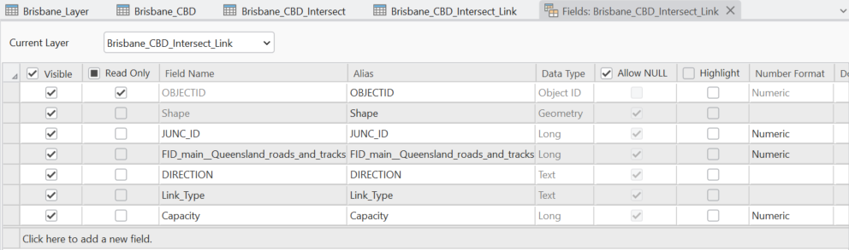
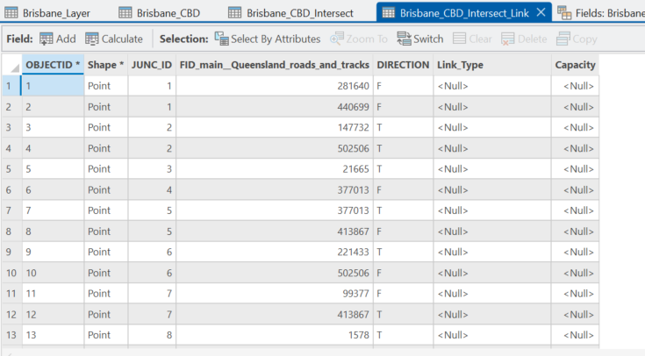
Add field “Link_Type” and Capacity > For “Brisbane_CBD_Intersect_Link” attribute table > Add > In “Fields: Brisbane_CBD_Intersect” > set “Field Name: Intersection_Type” > set “Data_Type : Text” from drop down list > Right click on “Fields: Brisbane_CBD_Intersect” and save

Slide 59
For a selected Intersection (node) identify the links associated from reality (google maps) and store the information
Add the field “Link_Type” and “Capcity” in the “Brisbane_CBD_Intersect_Link” attribute table, assign data type to be “Text” and “Long”, respectively, save the changes by right clicking on the “Fields:Brisbane_CBD_Intersect_Link”.
From the “Brisbane_CBD_Intersect_Link” attribute table select an intersection by id (JUNC_ID is 1 and FID is 281460) and right click on the record and select “Flash”.
Navigate to the flashing intersection on the map and click on the intersection links in the map.
Among the intersected links, click each one to identify the correct one by FID.
Right click on the intersection point in the map and select “Copy Coordinates”. Open a web browser, go to “https://www.google.com/maps” and paste the copied coordinates in the search bar and go to the location, select the street view window in the bottom right corner of the google map.
Based on the FID and the link in the map collect the information for “Link_Type” and “Capacity” and record it in the “Brisbane_CBD_Intersect_Link” layer attribute table under “Link_Type” and “Capacity”, respectively.
If additional information needs to be recorded for the links in the intersections, based on the information add a field to the “Brisbane_CBD_Intersect_Link” layer and repeat steps from 2 to 6 until all intersection links are populated.

Slide 60

In “Brisbane_CBD_Intersect_Link” attribute table select feature JUNC_ID is 1 (FID 281640) and right click on the record and select “Flash”.

Slide 61
For a selected Intersection (node) identify the links associated from reality (google maps) and store the information
Add the field “Link_Type” and “Capcity” in the “Brisbane_CBD_Intersect_Link” attribute table, assign data type to be “Text” and “Long”, respectively, save the changes by right clicking on the “Fields:Brisbane_CBD_Intersect_Link”.
From the “Brisbane_CBD_Intersect_Link” attribute table select an intersection by id (JUNC_ID is 1 and FID is 281460) and right click on the record and select “Flash”.
Navigate to the flashing intersection on the map and click on the intersection links in the map.
Among the intersected links, click each one to identify the correct one by FID.
Right click on the intersection point in the map and select “Copy Coordinates”. Open a web browser, go to “https://www.google.com/maps” and paste the copied coordinates in the search bar and go to the location, select the street view window in the bottom right corner of the google map.
Based on the FID and the link in the map collect the information for “Link_Type” and “Capacity” and record it in the “Brisbane_CBD_Intersect_Link” layer attribute table under “Link_Type” and “Capacity”, respectively.
If additional information needs to be recorded for the links in the intersections, based on the information add a field to the “Brisbane_CBD_Intersect_Link” layer and repeat steps from 2 to 6 until all intersection links are populated.

Slide 62
Go to the flashing intersection in the map and click on the intersection links in the map.
The copied coordinates : 153.0263827°E 27.4771771°S

Slide 63
For a selected Intersection (node) identify the links associated from reality (google maps) and store the information
Add the field “Link_Type” and “Capcity” in the “Brisbane_CBD_Intersect_Link” attribute table, assign data type to be “Text” and “Long”, respectively, save the changes by right clicking on the “Fields:Brisbane_CBD_Intersect_Link”.
From the “Brisbane_CBD_Intersect_Link” attribute table select an intersection by id (JUNC_ID is 1 and FID is 281460) and right click on the record and select “Flash”.
Navigate to the flashing intersection on the map and click on the intersection links in the map.
Among the intersected links, click each one to identify the correct one by FID.
Right click on the intersection point in the map and select “Copy Coordinates”. Open a web browser, go to “https://www.google.com/maps” and paste the copied coordinates in the search bar and go to the location, select the street view window in the bottom right corner of the google map.
Based on the FID and the link in the map collect the information for “Link_Type” and “Capacity” and record it in the “Brisbane_CBD_Intersect_Link” layer attribute table under “Link_Type” and “Capacity”, respectively.
If additional information needs to be recorded for the links in the intersections, based on the information add a field to the “Brisbane_CBD_Intersect_Link” layer and repeat steps from 2 to 6 until all intersection links are populated.

Slide 64


Of the intersected links click the link (Pop-up) and identify if it is the correct link, from FID and ObjectID, if not click the remaining links and find the correct link.

Slide 65
For a selected Intersection (node) identify the links associated from reality (google maps) and store the information
Add the field “Link_Type” and “Capcity” in the “Brisbane_CBD_Intersect_Link” attribute table, assign data type to be “Text” and “Long”, respectively, save the changes by right clicking on the “Fields:Brisbane_CBD_Intersect_Link”.
From the “Brisbane_CBD_Intersect_Link” attribute table select an intersection by id (JUNC_ID is 1 and FID is 281460) and right click on the record and select “Flash”.
Navigate to the flashing intersection on the map and click on the intersection links in the map.
Among the intersected links, click each one to identify the correct one by FID.
Right click on the intersection point in the map and select “Copy Coordinates”. Open a web browser, go to “https://www.google.com/maps” and paste the copied coordinates in the search bar and go to the location, select the street view window in the bottom right corner of the google map.
Based on the FID and the link in the map collect the information for “Link_Type” and “Capacity” and record it in the “Brisbane_CBD_Intersect_Link” layer attribute table under “Link_Type” and “Capacity”, respectively.
If additional information needs to be recorded for the links in the intersections, based on the information add a field to the “Brisbane_CBD_Intersect_Link” layer and repeat steps from 2 to 6 until all intersection links are populated.

Slide 66
Open a web browser, go to google.maps and paste the copied coordinates in the search bar and select the street view window in the bottom right corner of the google map

Slide 67
For a selected Intersection (node) identify the links associated from reality (google maps) and store the information
Add the field “Link_Type” and “Capcity” in the “Brisbane_CBD_Intersect_Link” attribute table, assign data type to be “Text” and “Long”, respectively, save the changes by right clicking on the “Fields:Brisbane_CBD_Intersect_Link”.
From the “Brisbane_CBD_Intersect_Link” attribute table select an intersection by id (JUNC_ID is 1 and FID is 281460) and right click on the record and select “Flash”.
Navigate to the flashing intersection on the map and click on the intersection links in the map.
Among the intersected links, click each one to identify the correct one by FID.
Right click on the intersection point in the map and select “Copy Coordinates”. Open a web browser, go to “https://www.google.com/maps” and paste the copied coordinates in the search bar and go to the location, select the street view window in the bottom right corner of the google map.
Based on the FID and the link in the map collect the information for “Link_Type” and “Capacity” and record it in the “Brisbane_CBD_Intersect_Link” layer attribute table under “Link_Type” and “Capacity”, respectively.
If additional information needs to be recorded for the links in the intersections, based on the information add a field to the “Brisbane_CBD_Intersect_Link” layer and repeat steps from 2 to 6 until all intersection links are populated.

Slide 68


From the street view gather relevant information for the link associated with the intersection and record it in the attribute table of “Brisbane_CBD_Intersect_Link” layer > Double click on cell adjacent to the relevant JUNC_ID is 1 and FID is 281460 under the fields Link_Type and Capacity with “Freeway” and 2400, respectively. Save the ArcGIS project (Ctrl + S)

Slide 69
Task 3: From the attribute tables for intersections and their respective links fill the relevant information
For the intersection and intersection link spatial information obtained for “Goldcoast city” add new fields.
For every intersection copy the coordinates and use it in google.maps and obtain information for the intersection and populate the intersection attribute table.
Similarly, for the intersection links use google.maps and obtain information for the intersection links and populate the intersection link attribute table.

Slide 70
Data provided for the presentation and course
For this presentation ‘QSC_Extracted_Data’ contains Queensland roads and tracks data.
For this course ‘SEQ_Roads_Tracks_Teaching” is the ArcGIS project which contains spatial data for the links, intersections, links associated with intersections as separate layers named as “SEQ_roads_tracks”, “SEQ_Intersection” and “SEQ_Intersection_Links”, respectively.

Slide 71
Thank You!

